Slide 1
Digital Resources for Literature Research
By Kirin Qi（齐 麟）
Kirin.qi@cengage.com
17th Novembr, 2015

Slide 3
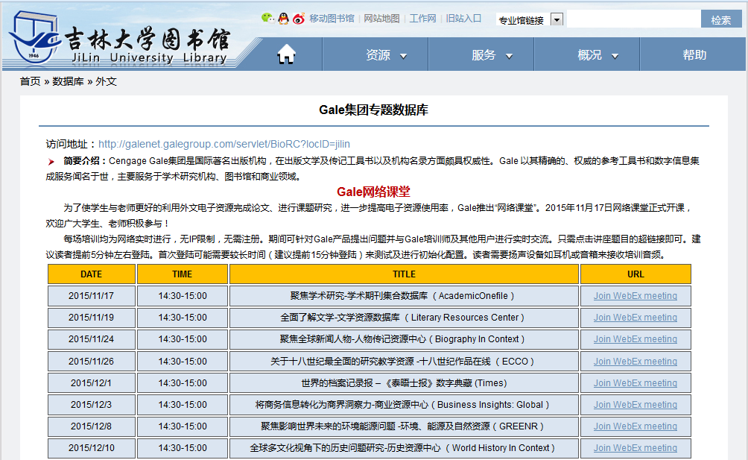

Slide 4
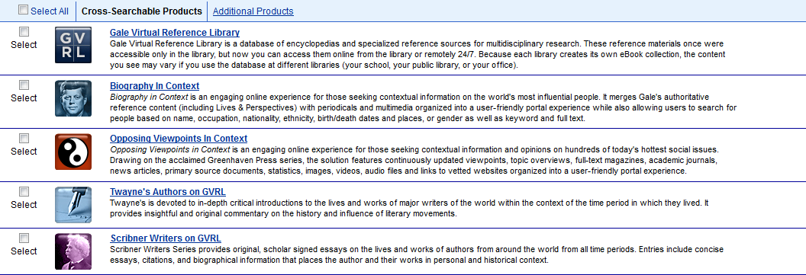

Slide 5
Literature Resource Center （文学资源中心）
MLA International Bibliography （现代语言协会国际书目）
Artemis Literary Sources （文学资源检索平台）
Biography In Context （人物传记资源中心）
Eighteenth Century Collections Online （十八世纪作品在线）

Slide 6
Gale文学资源中心+MLA书目

Slide 7
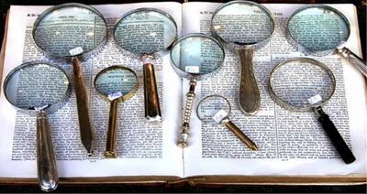
Why Study Literature?
（文学-不可或缺）

Slide 8
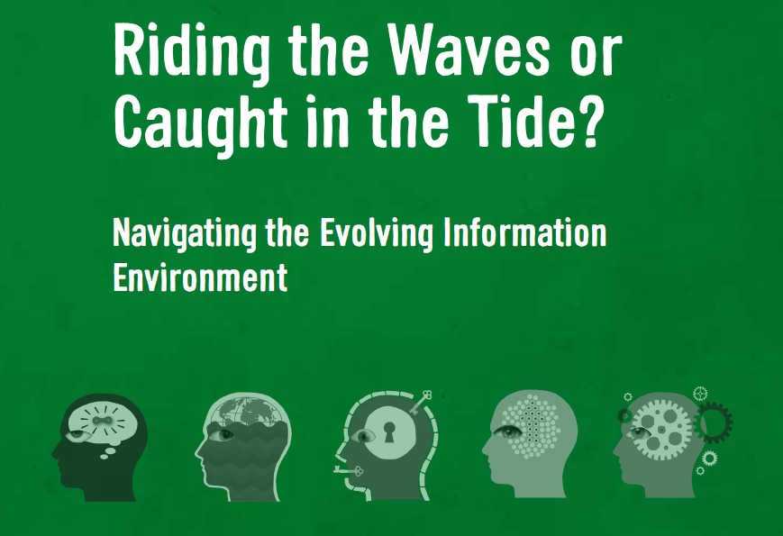
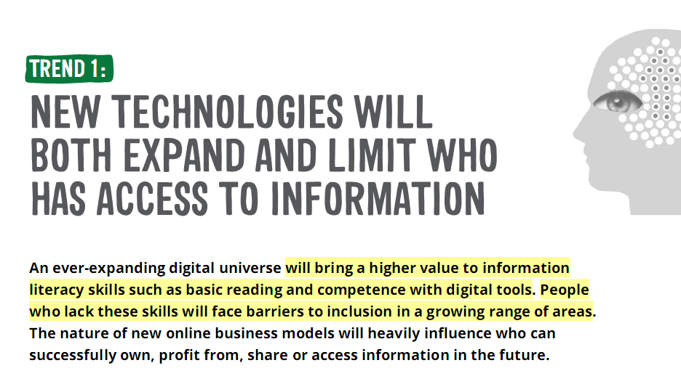
IFLA Trend Report
让你的思维乘风破浪，还是随波逐流?
阅读及掌握信息的能力

Slide 9
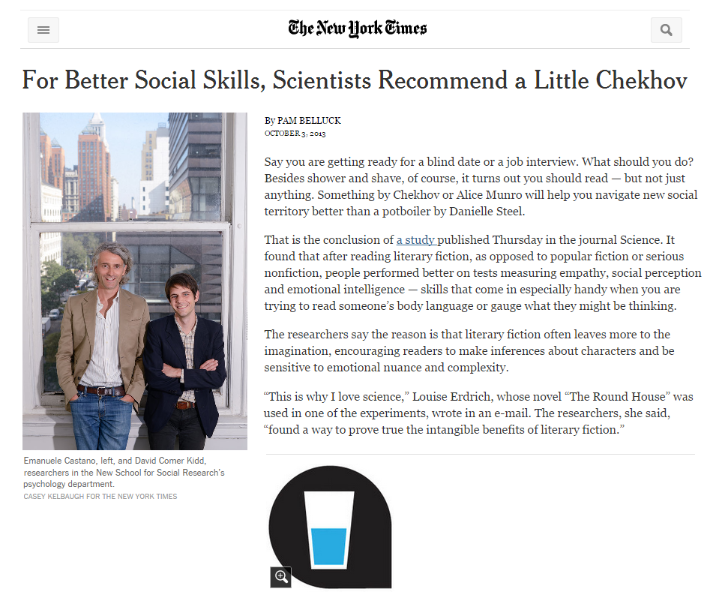

Slide 10
The Value of Literary Study
Stimulates reading, thinking, discussing, and writing
培养阅读，思考，讨论及写作的能力
Enhances critical thinking skills and thought expression
提高批判性思维和思维表达能力
Expands our capacity to sympathize with other human beings
增强同感力
Enhances our ability to see and imagine human complexity
增强对复杂环境的观察力和想象力
Broadens our intellectual horizons by enlarging our power to experience life in another person’s place
拓展视野，体验不同人生感悟

Slide 11
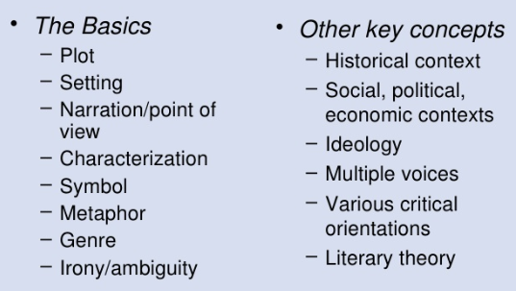
Analysis of Literature
Notes:
Defend your argument with evidence like
Quotes/excerpts/paraphrasing based on the text
Historical/cultural context as well as biographical information about the author
Analysis done by other critics (literary criticism)

Slide 12
Deeper Understanding for Writing An Analysis
Primary Material:
The work
Bibliographies
Biographical works
Criticisms, Reviews
Dictionaries, Encyclopedias
Journal articles
Magazine and newspaper articles
Monographs
Multimedia

Slide 13
Literature Resource Center （文学资源中心）
Critical biographies of authors, bibliographies of works
相关人物传记， 作品相关文献
Literary reviews, critical writings, topical essays
文学评论， 相关文章
Explanations of notable works, themes, characters
杰出作品，主旨，特点解析
Links to related websites, author interviews, etc.
相关网址链接及作家访谈等
The MLA International Bibliography （现代语言协会国际书目）
Bibliography of works on literature, linguistics and folklore
现代语言、文学、语言学、民俗学及其它相关主题文献及期刊文章，最具代表性的书目数据库

Slide 14
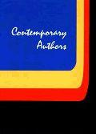
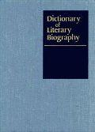
Biographies 传记资料
来自Gale 知名的系列丛书如《当代作家》、《文学传记词典》等
总共160,000多篇作者传记，这些传记提供了150,000多位世界范围、跨时代的作者的传记和书目
11,000多份当代作家的采访资料
3,500多张作家图片和肖像
14

Slide 15
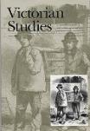
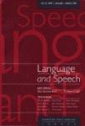
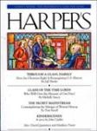
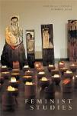
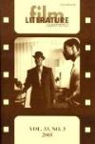
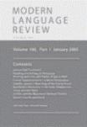
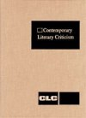
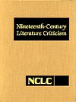
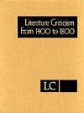
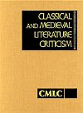
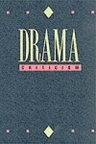
Literary Criticism 文学评论
来自于490余份全球全文期刊的丰富信息，包括文学、语言学、作家介绍等期刊，提供约1000,000篇全文文章
选自Gale 集团出版的众多著名文学评论系列参考书，超过78,000篇文学评论文章(CLC, TCLC, NCLC, CMLC, etc.) ---独家版权
15

Slide 16
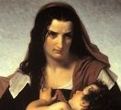
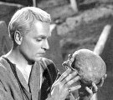
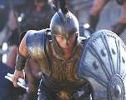
Other Material 其他
超过7,000篇作品/人物的概述，注解，分析，评论
可链接至12,900个经过专家严格挑选的文学和作家的相关站点
78,000篇书评、戏评及影评
3,000多个链接到 National Public Radio (NPR) 的多媒体影像资料
43,000篇当代诗歌、短片小说和戏剧全文
超过10,000条文学术语定义，来自《韦氏文学大百科全书》
整合来自“MLA现代语言协会”推荐的200万条书目信息，并且Gale数据库中75%以上的内容能通过MLA直接链接
16

Slide 17
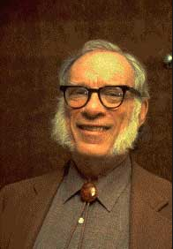
Isaac Asimov （艾萨克·阿西莫夫）
Start A Tour
I, Robot 机械公敌， 2004

Slide 18
A Deep Understanding
What was Asimov’s personal life, and how is it reflected in his work?
What important literary criticism has been published on Asimov?
What are the reviews of recent performances on his work?
What other Authors or fictions with similar themes exist?
What other research has been published regarding Asimov?
Biography
Literary Criticism
Reviews
Person/Works Search
MLA International Bibliography

Slide 20
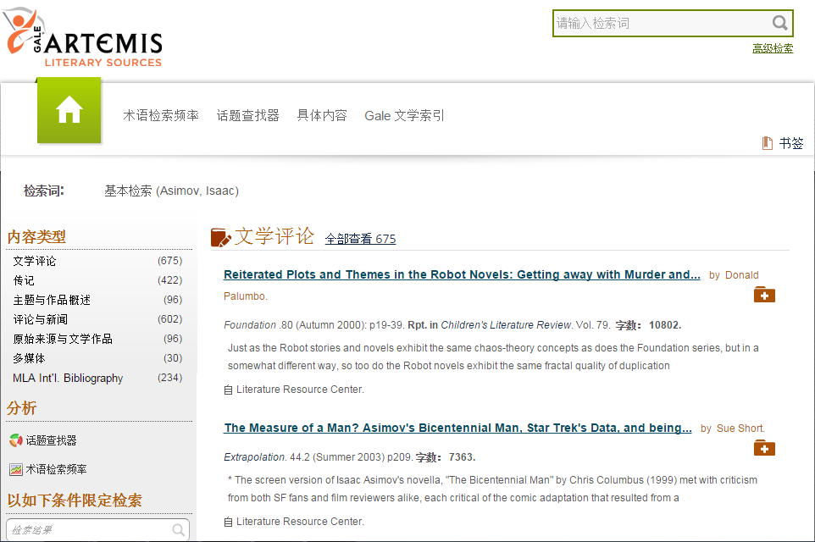
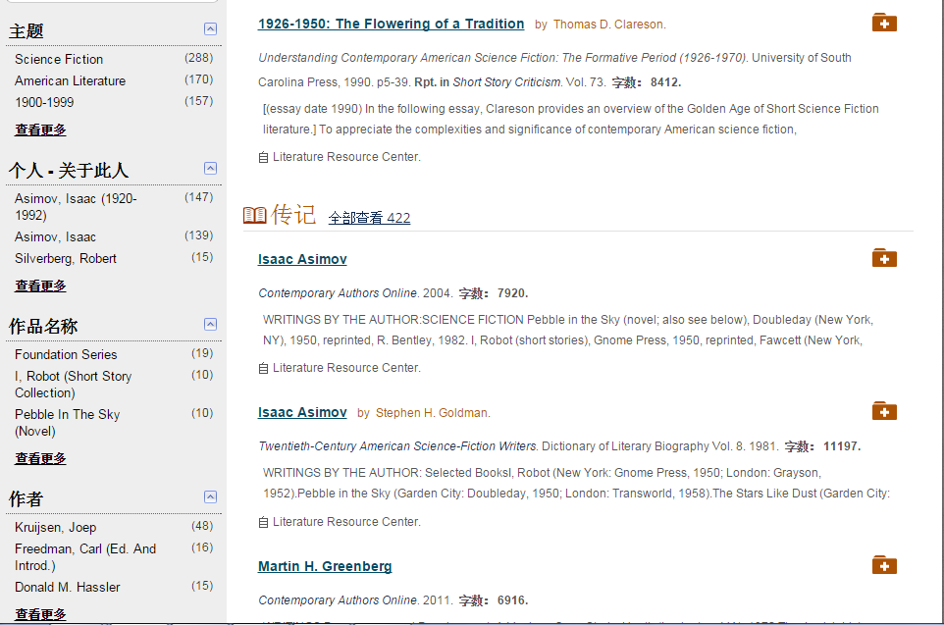
Top 3 search results of each content type
Filters to narrow down search results条件筛选

Slide 21
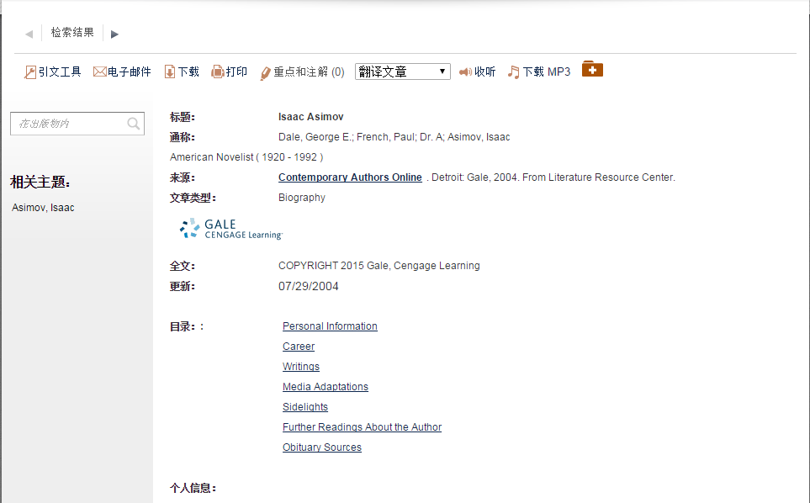
Biography
人物传记
Notes:
Biography
门萨是世界顶级智商俱乐部，于1946年成立于英国牛津，目前汇聚了遍及世界100多个国家和地区的十几万名会员。俱乐部通过充满挑战性的社团活动而使参与者的高智商获得承认、肯定和不断提高，并分享彼此的成功。作为一个平等的非盈利组织，门萨尊重每个会员的见解与选择，并努力为会员提供各种观点都可以被交流、讨论的环境。
如欲入会者须通过该会所提供之测试(Mensa Test)，以证明申请人之智商为当地人口中最高的百份之二。另外部份国家之Mensa分会亦接受申请人以该会接受之组织所提供之智商测试证明。该会强调除智商外，种族、肤色、宗教、职业等因素均不会影响入会申请。

Slide 22
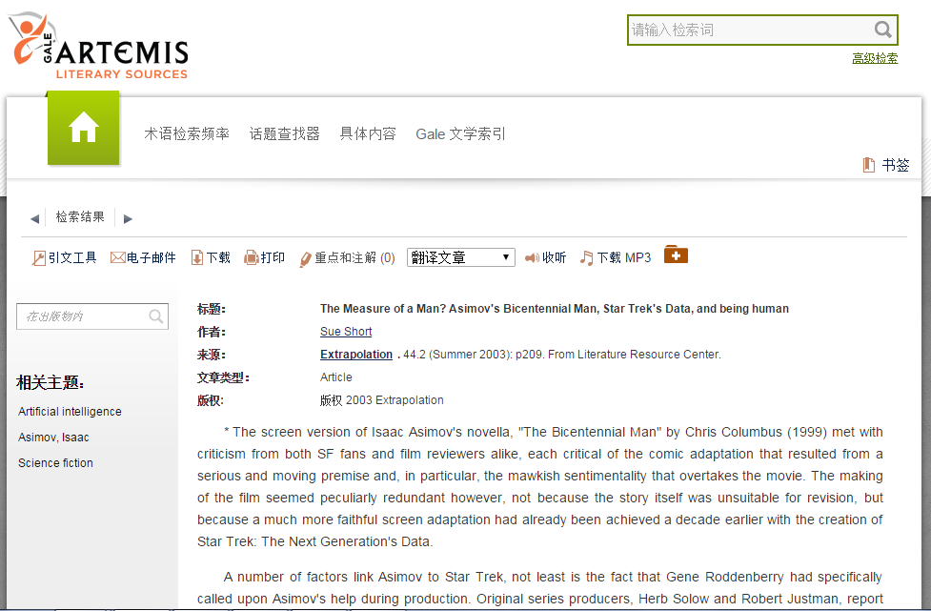
Literature criticism
文学评论
Notes:
Literature Criticism
Cyborg Cinema 机器人电影 ， 关于X档案，吸血猎人巴菲，迷失，英雄，Doctor who, 和星际迷航的分析

Slide 23
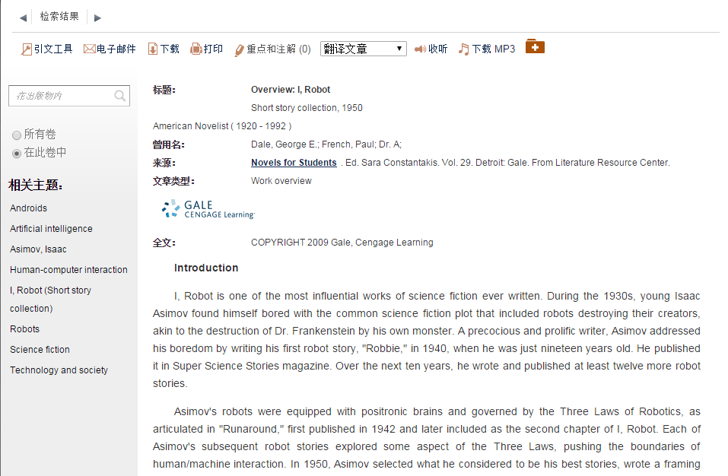
About Gale
Topic & Work Reviews
作品概述/主题评论

Slide 24
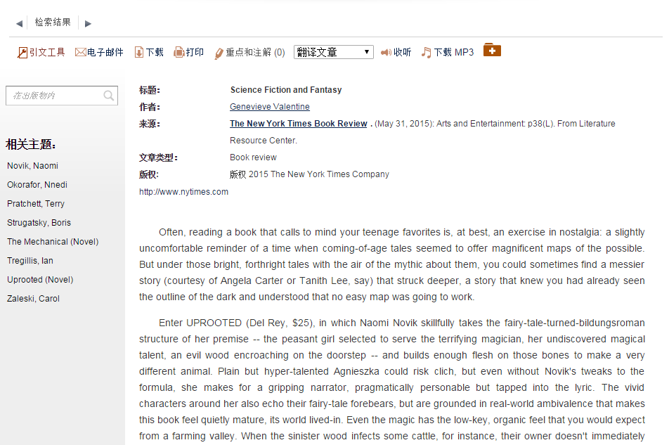
Reviews & News新闻与评论

Slide 25
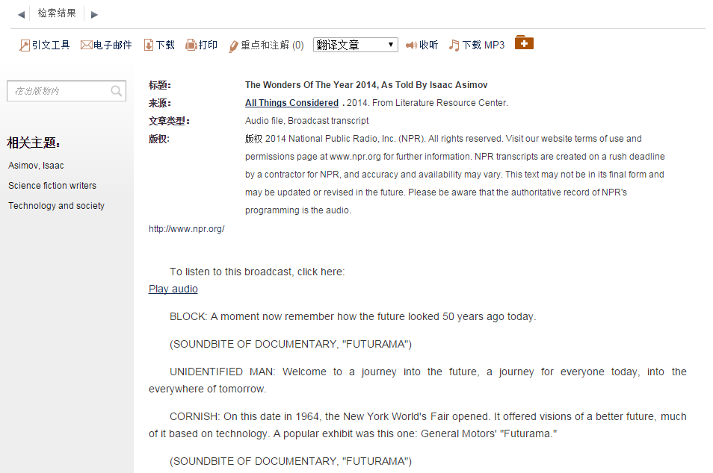
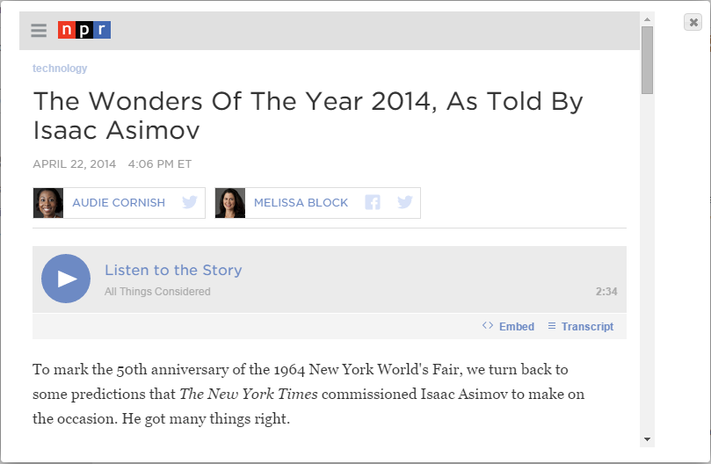
Multimedia
影音资源/多媒体

Slide 26
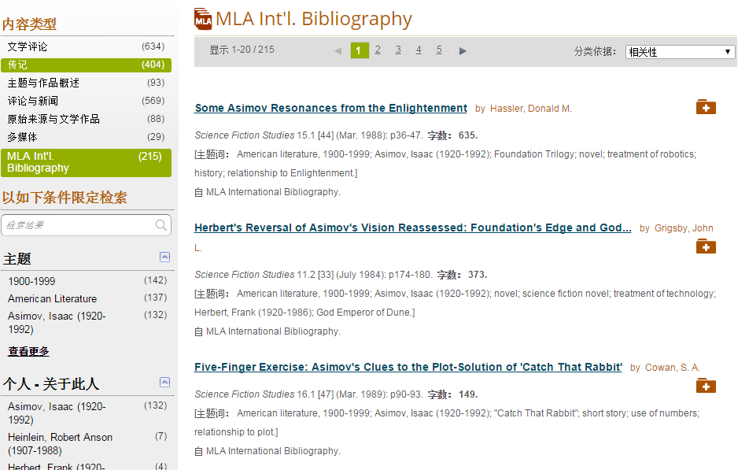
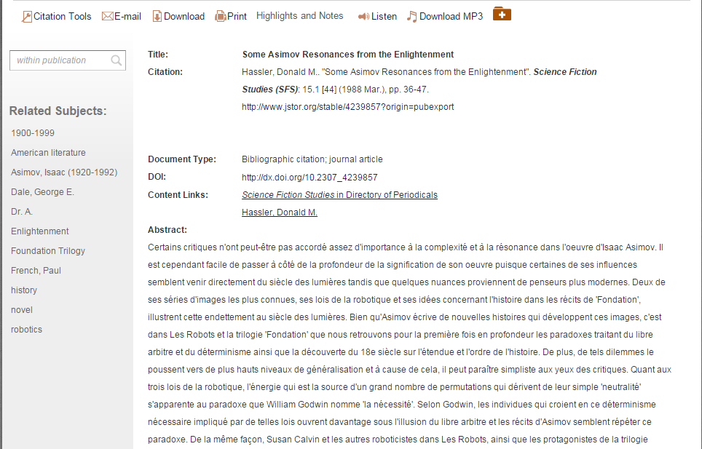
Notes:
Other Research

Slide 27
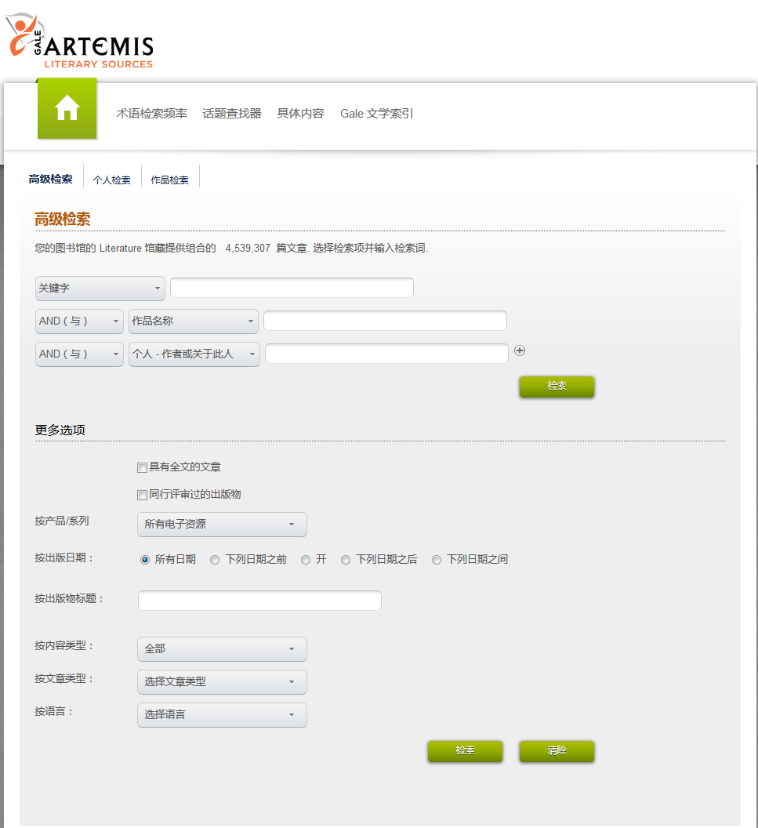
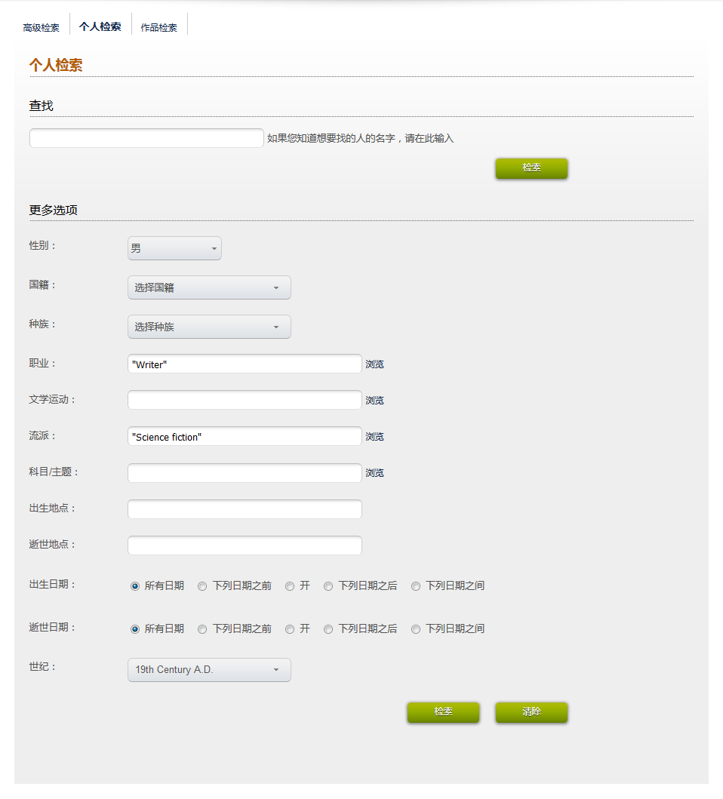
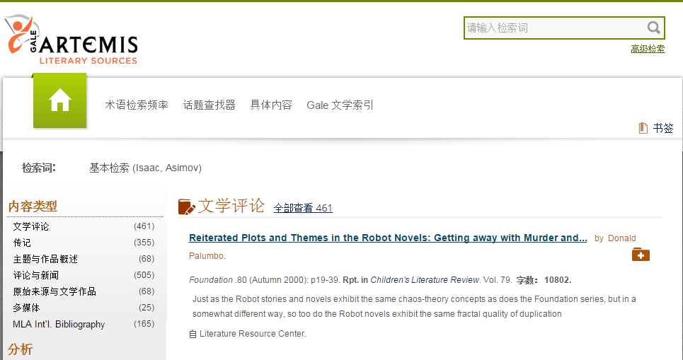
Person/ Work Search （作家/作品搜索）

Slide 28
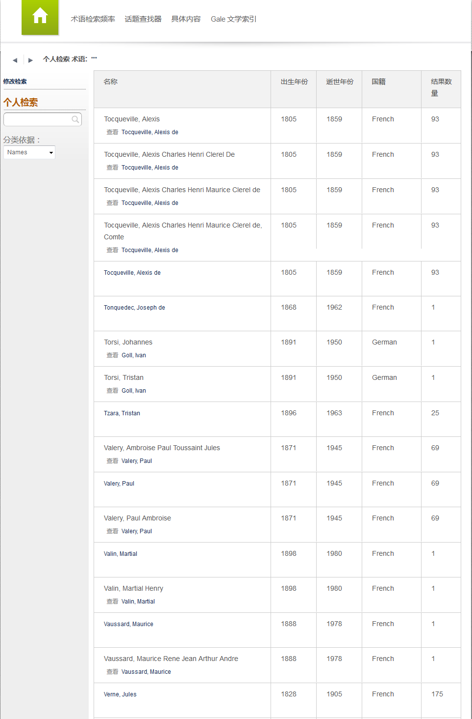
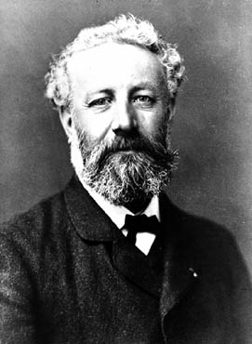
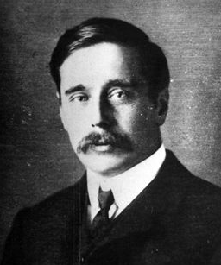
Verne, Jules
Herbert George Wells
Notes:
儒勒·凡尔纳： 《格兰特船长的儿女》《海底两万里》《神秘岛》以及《气球上的五星期》《地心游记》科幻小说之父，科幻小说三大奠基人之一
赫伯特·乔治·威尔斯: 时间机器, 透明人， star War

Slide 29
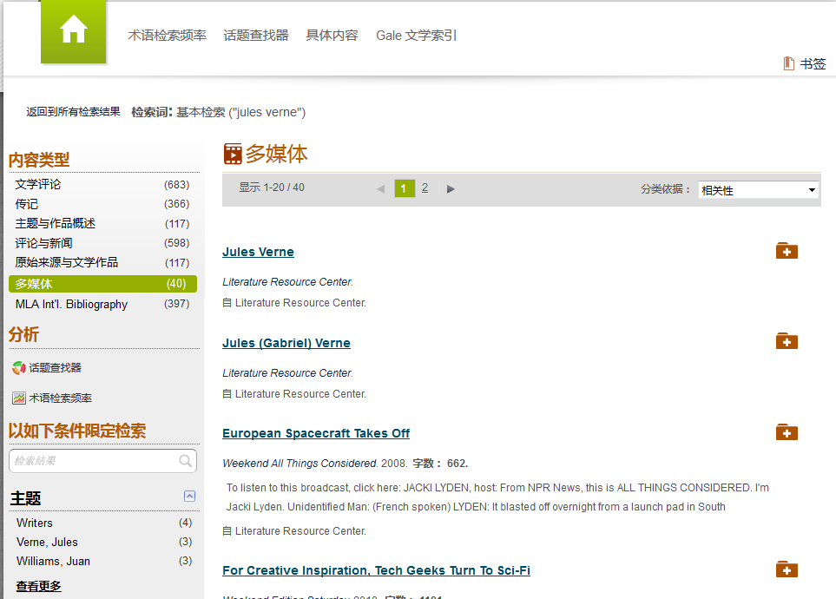

Slide 30
A Whole Understanding
What was Asimov’s personal life, and how is it reflected in his work?
What important literary criticism has been published on Asimov?
What are the reviews of recent performances on his work?
What other Authors or Science fictions with similar themes exist?
What other research has been published regarding Isaac Asimov?
Biography
Literary Criticism
Reviews
Person/Works Search
MLA International Bibliography

Slide 31
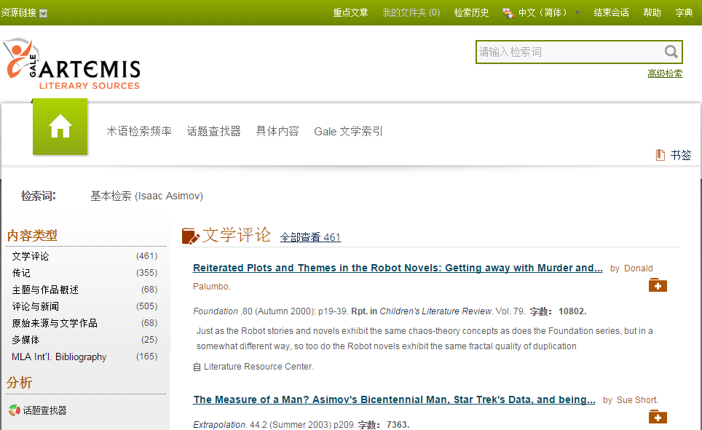
Important!!
Your saved articles and folder are session-specific!
To save them beyond your current session, remember to print, e-mail, or download the annotated document before leaving your session
Notes:
Add An article to your folder

Slide 32
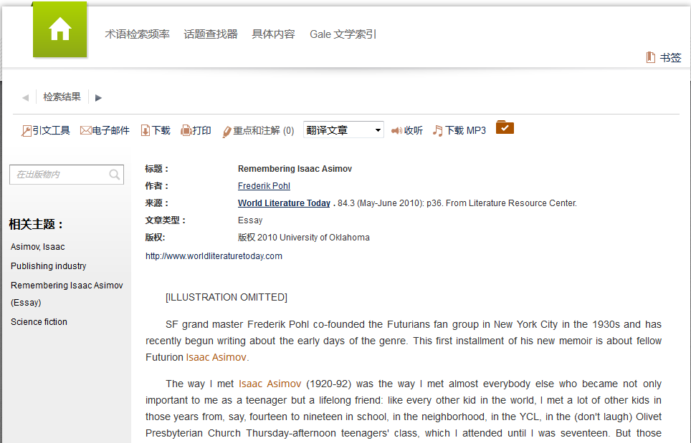
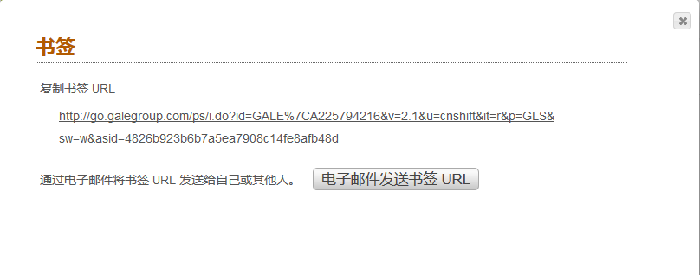
Notes:
Book Mark an Article 下一张-各种工具

Slide 33
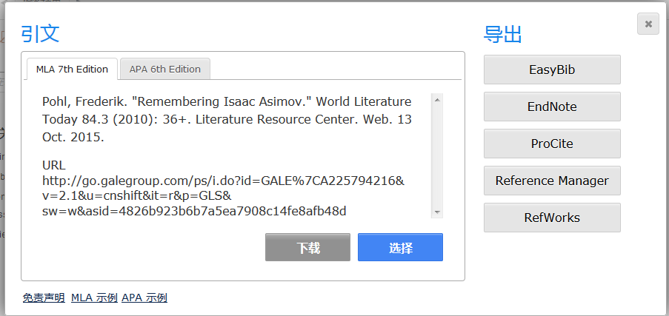
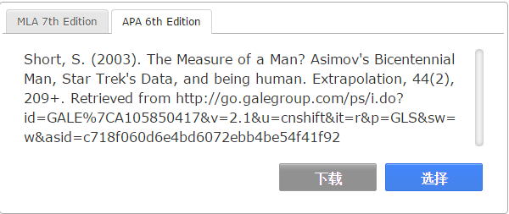
Important!!
Your highlights and notes are session-specific!
To save them beyond your current session, remember to print, e-mail, or download the annotated document before leaving your session
Notes:
各种工具, 顺序引文-邮件/下载/打印-MP3- 注释及笔记 – 全文翻译

Slide 34
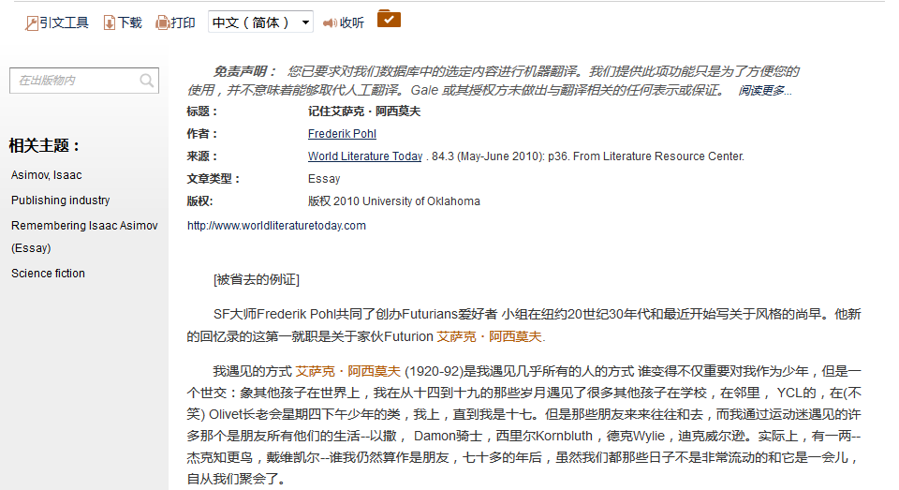
Full-Text Translation (文章翻译）
Notes:
23种语言的机器翻译

Slide 35
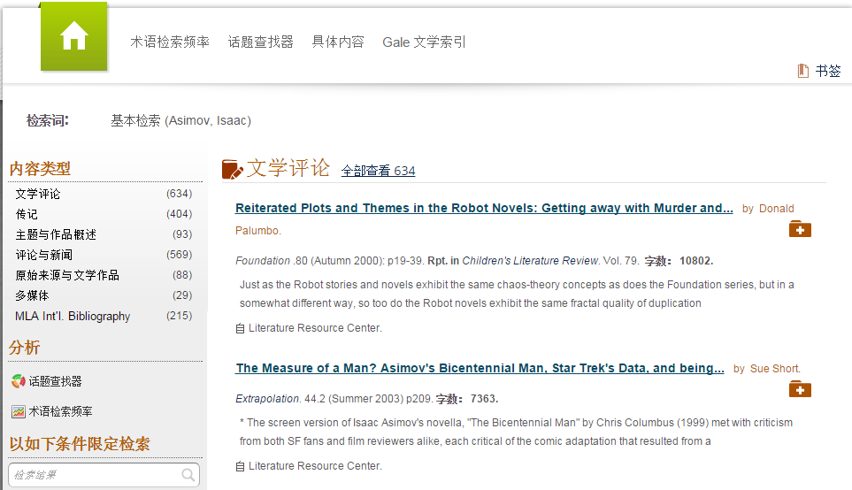

Slide 36
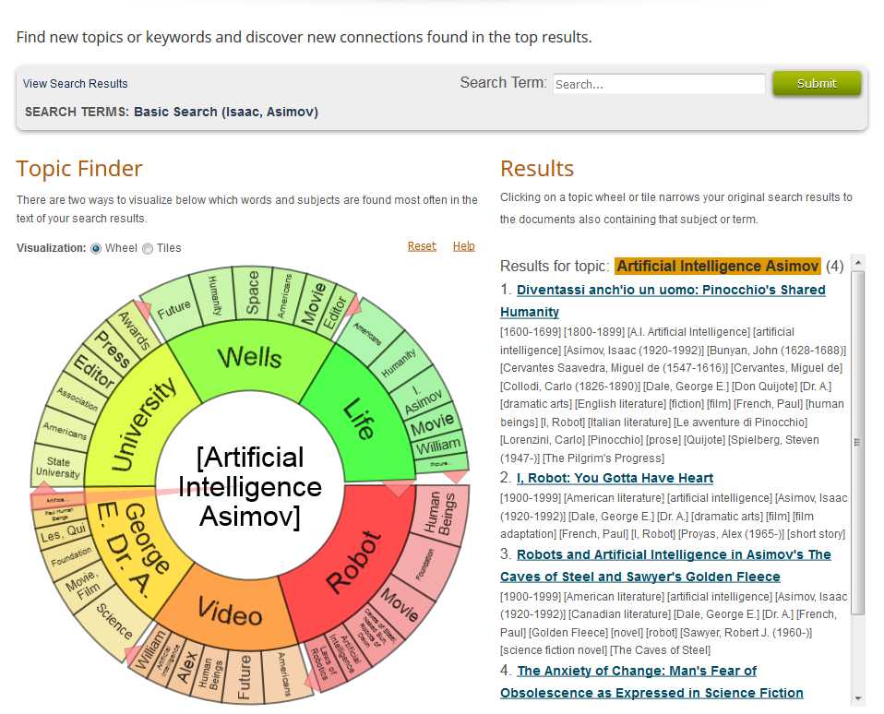
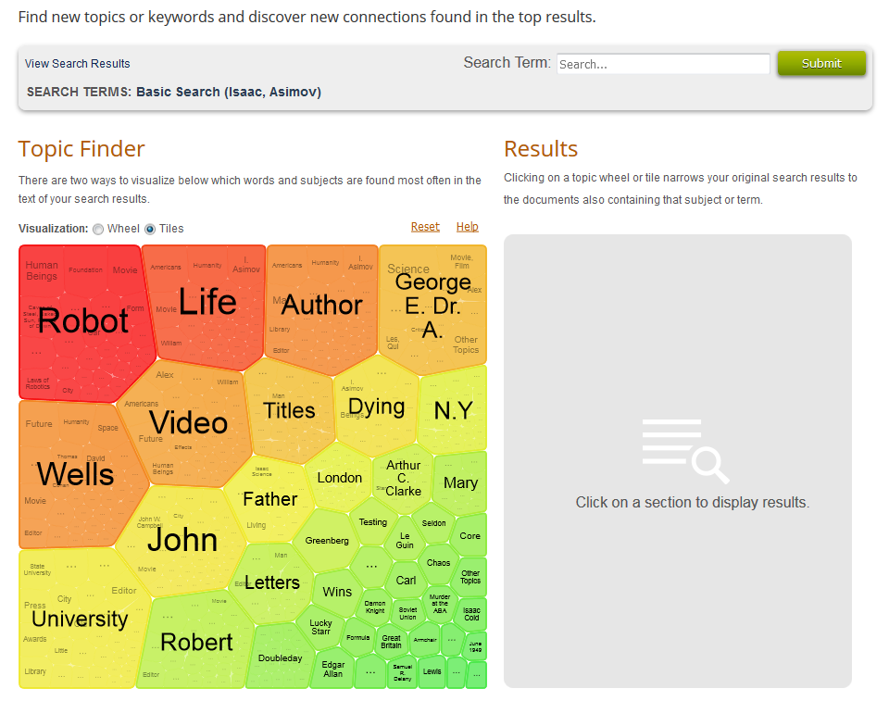
Topic Finder
Notes:
此工具抽取标题、主题并从顶部结果的子集中提取大约前 100 个字，然后将它们纳入到一个算法。图形中显示的关键字是使用检索词在文稿中找到的最常见字词。

Slide 37
Term Frequency （词频工具）

Slide 38
Re-Cap A Journey of Literature （回顾）
Primary Material:
The Work
Secondary Material:
Bibliographies
Biographical works
Criticisms, Reviews
Dictionaries, Encyclopedias
Journal articles
Magazine and newspaper articles
Monographs
Multimedia

Slide 39
人物传记资源中心

Slide 40
Contents (数据库内容)
全球52.5万人物的66多万份传记，每年新增或更新5万个人物
Gale 出版的众多著名商业参考书，如: 《Encyclopedia of World Biography》、《American Men & Women of Science》等等。
介绍各个学科、各个领域、不同国家、种族的著名人物的传记资料
来自于430多份全文学术期刊、杂志的丰富信息
可链接到12,000个经过权威考察过的世界著名人士的官方和权威网址，每年新增数千个相关网站。
传主的生平资料、得奖情况、从事的职业或从事的研究等相关详实的资料

Slide 41
人物浏览
检 索
人物聚焦
精选视频和新闻
人物分类浏览

Slide 42
人物浏览

Slide 44
Example: Coco Chanel 可可·香奈儿
What was Chanel’s personal life like?
What were her achievements and faults?
What are the recent media writing about Chanel?
Find other designers related to Chanel

Slide 45
检索方式 - 基本检索
检索词联想帮助

Slide 46
A Topic Page on Coco Chanel

Slide 55
Example: Coco Chanel
What was Chanel’s personal life like?
What were her achievements and faults?
What are the recent media writing about Chanel?
Find other designers related to Chanel

Slide 57
Ctrl + click to select multiple

Slide 59
Divider slide
Subtitle, Arial 18pt

