Slide 1
Eighteenth Century
Collections Online
（十八世纪作品在线）

Slide 2
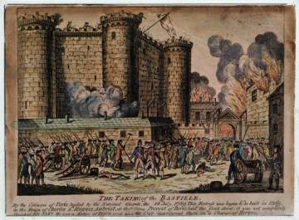
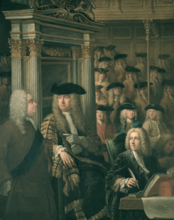
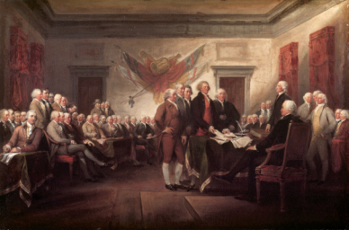
The Eighteenth Century
Many significant events and developments occurred in the Eighteenth Century:
The French Revolution
The American Revolution
The Industrial Revolution
The Enlightenment
The development of Capitalism
The birth of economic & political theory
The emergence of the ‘middle class’
The birth of the ‘novel’
Neoclassicism
Romanticism
Rococo

Slide 3
Eighteenth Century Collections Online
Nearly every significant title printed in Britain in the 18th century, along with thousands from other regions
1701-1800年各地英文及英属殖民地出版物
33 million pages full-text searchable – facilitating new discoveries and revolutionizing historical research
收录超3300万页，138,000种图书资料
Supports research in a full range of disciplines （Literature, history, fine arts, religion, law, philosophy, music, science …）
收录文章涵盖几乎所有领域（文学，历史，艺术，宗教，
法律，哲学，音乐，科学等）
Notes:
学术界工人的研究18C的必备权威资源， Scanned from the microfilm series, The Eighteenth Century (17,828 reels, complete)
Original material held in the British Library, the Bodleian Library, Huntington Library, UCLA Clark Library, etc.

Slide 4
历史及地理 History & Geography | 古代及当代历史( Ancient and contemporary history);航海记及 新发现 (Accounts of voyages and discoveries);历史传记及论文 集 (Historical biographies and memoirs);系谱总汇 (Genealogical collections)地名辞典 (Gazetteers);有关古代教会的著作 (Works on church antiquities)
社会科学 Social Science | 当今事件、社会改革、商业/ 经济/ 金融 (广告概要、发行彩 票、贸易法案等)、政治科学（议会文件、政治评论、演讲稿 ／致辞、传单 、教堂记事簿等）、制造业者及贸易商 (Manufacturers and merchants);工匠 (Artisans);技术工人 (Skilled Workers);国际商业 (International business);银行业、 税收及发行彩票 (Banking, taxation &lotteries)
美术、音乐、艺术及建筑学古代及当代历史 Fine Arts, Music, Art & Architecture | 音乐、绘画、戏剧及建筑学论著 (Treatises on music, painting, theatre and architecture);有关建筑及木工工作的书籍 (Books on building and carpentry);声乐作品及乐器的相关目录 (Catalogs pertaining to vocal and instrumental music) ;绘画、印刷及制图 (Paintings, prints, drawings);硬币、金属及其它可收集品 (Coins and metals and other collectibles);私人艺术收藏品 (Material about private art collections)

Slide 5
医学、科学及科技 Medicine, Science & Technology | 主题包括：农业、食谱、军事技术、自然哲学、科学教育等 科学的许多分支学科 (Many branches of science);应用科学技术 的著作 (Works on applied science & technology);疾病治疗的相 关著作及论述 (Works & treatises on the treatment of diseases and conditions)
文学及语言 Literature and Language Module | 主题包括：戏剧、诗歌、民谣、宗教类诗歌、语法、词典、 戏剧歌 曲、讽刺小说、书目等等。十八世纪著名评论家、小说家、诗人及剧作家 (Celebrated eighteenth-century essayists, novelists, poets and playwrights);莎士比亚剧本、诗歌及文集 (Shakespeare’s plays, poems and collected works)
宗教及哲学 Religion and Philosophy | 布道 (Sermons);《圣经》(Bibles);祈祷书 (Prayer books);伦理与 道德争论和恰当行为规范 (Moral and ethical debates and prescriptions for proper conduct)
法律 LAW | 主题包括:《圣经‧新约》《使徒行转》、犯罪及国际法、上诉 案例 等等…。大英帝国1701年至1800年间的法律发展 (Development of law in the British Empire between 1701 and 1800)
参考综述 General Reference | 主题包括：年鉴、目录等十八世纪整个生命界短暂的物质 (Ephemeral material on the whole of life in the eighteenth century)

Slide 6
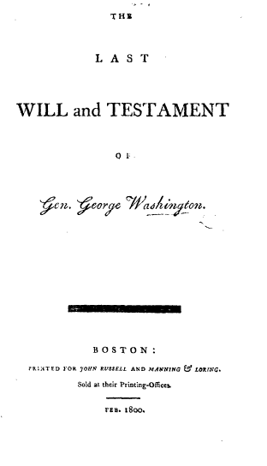
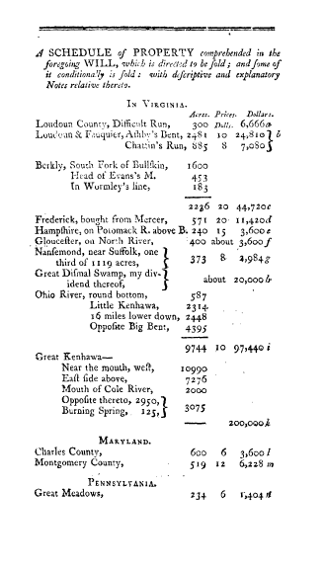
华盛顿遗嘱

Slide 7
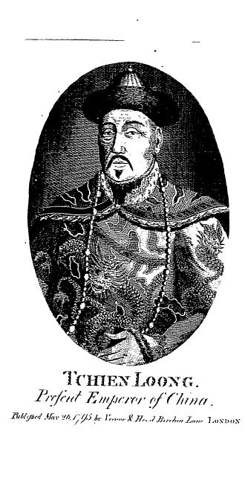
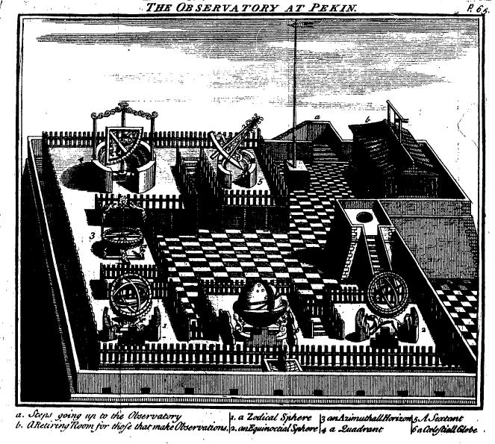
中国皇帝乾隆的肖像
北京古观象台

Slide 8
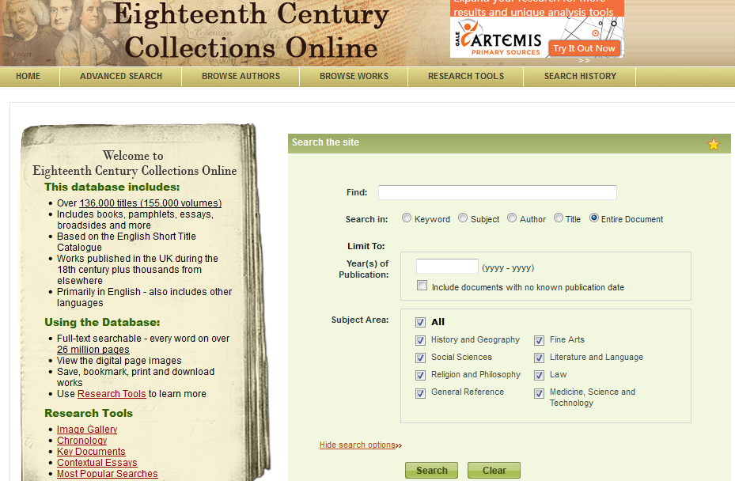
首页 | 高级检索 | 作家浏览 | 作品浏览 | 研究工具
关键字 | 学科 | 作家 | 作品 | 全文
出版时间
学科限定

Slide 9
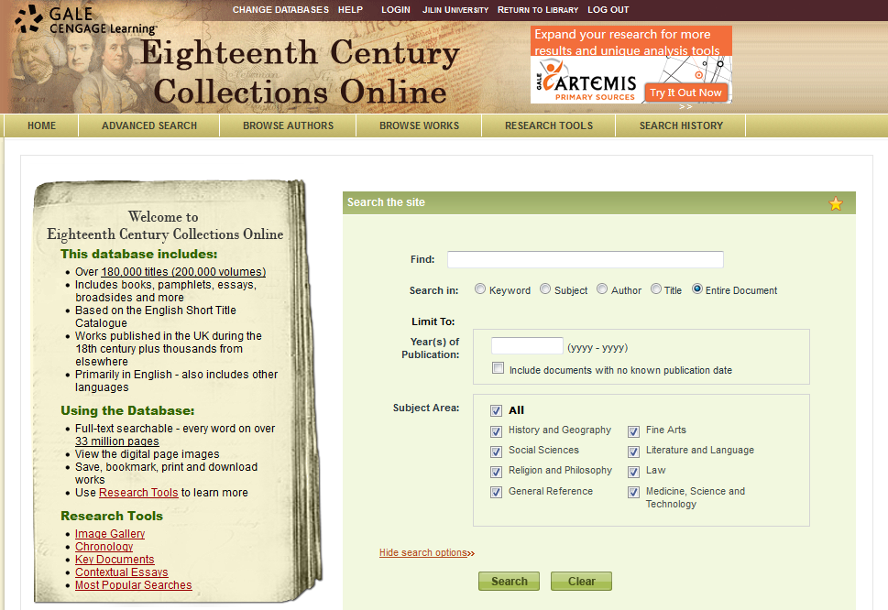

Slide 10
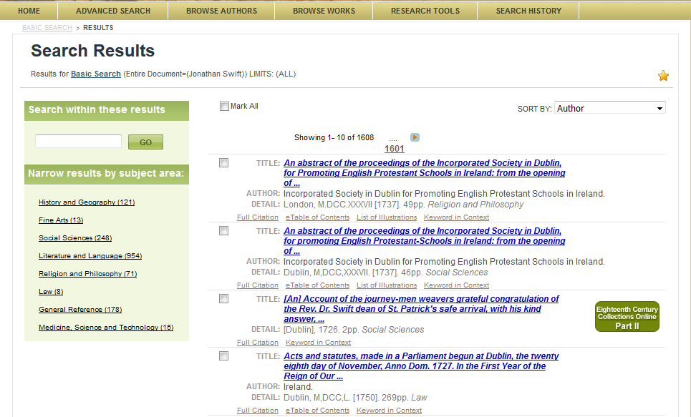

Slide 11
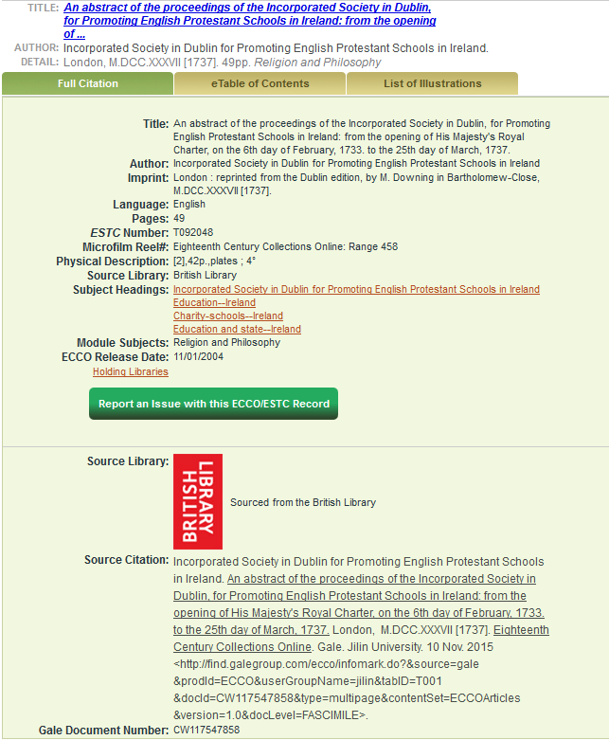
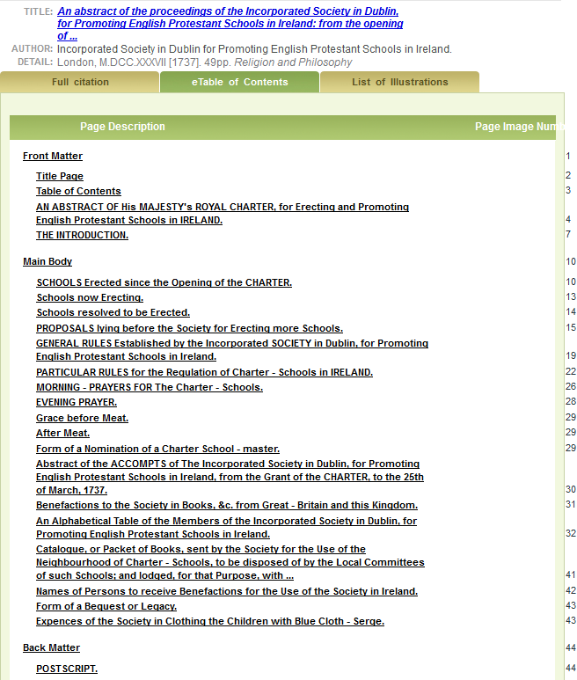
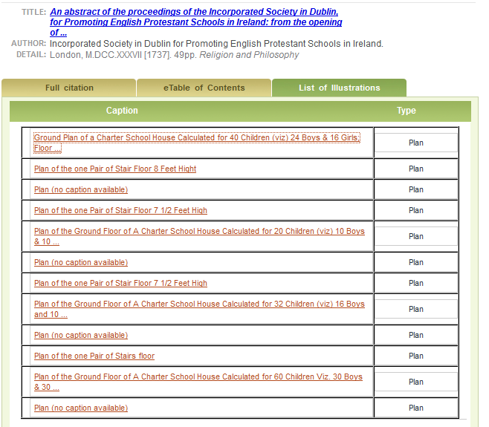
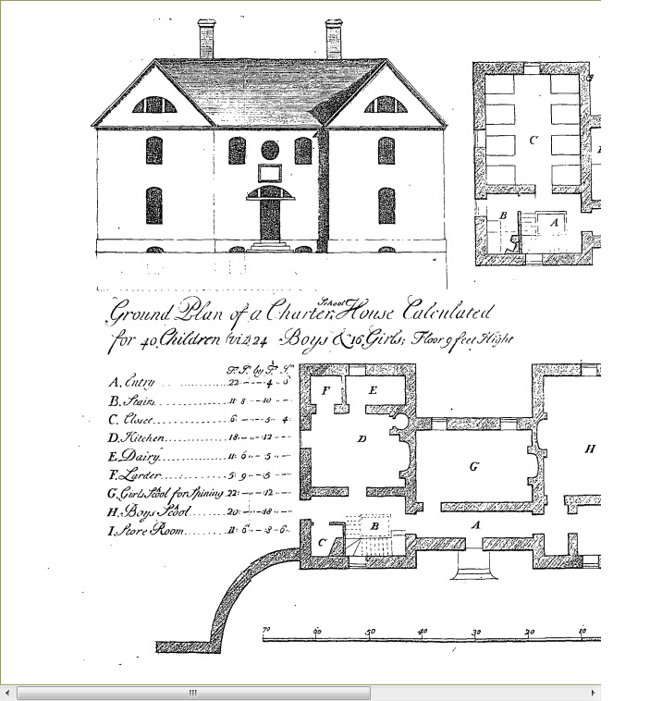
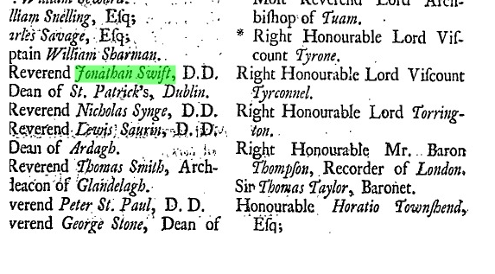

Slide 12
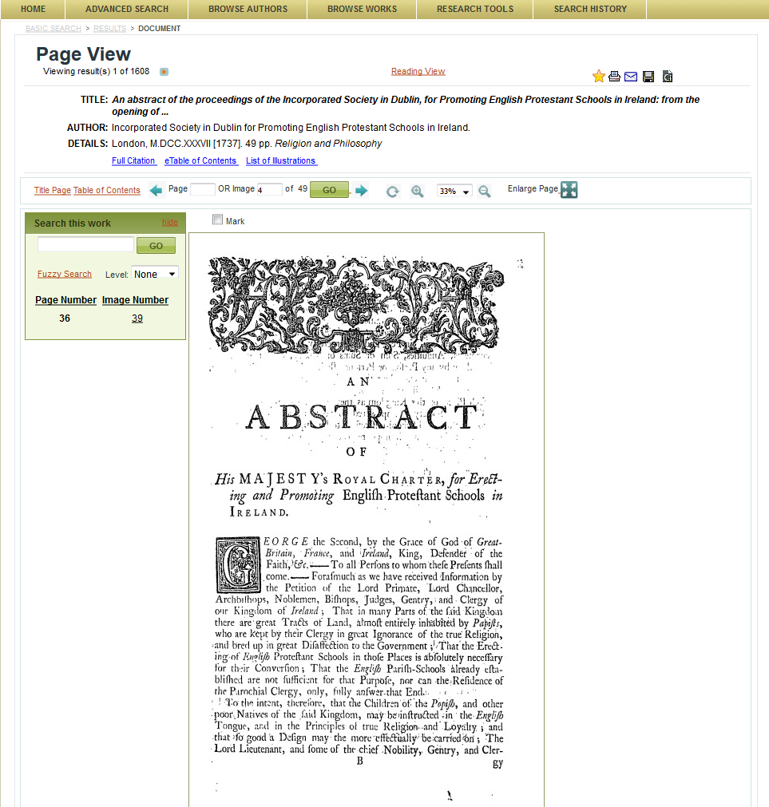
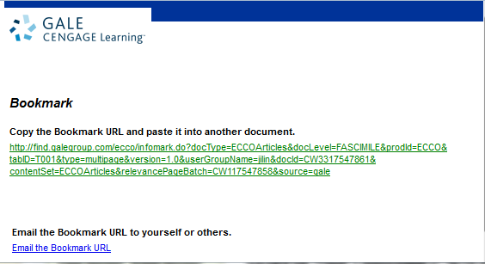
Page View
书签|打印|邮件|保存|引文工具

Slide 13
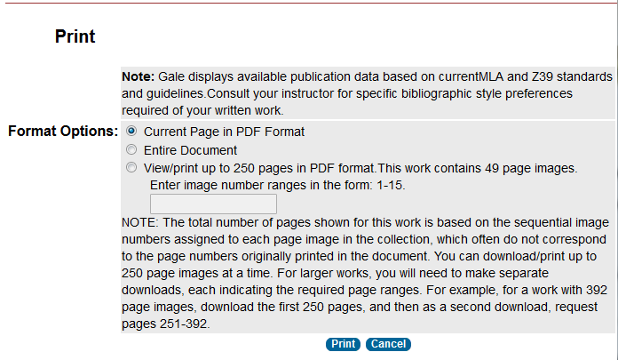
Navigation Tools-Print

Slide 14
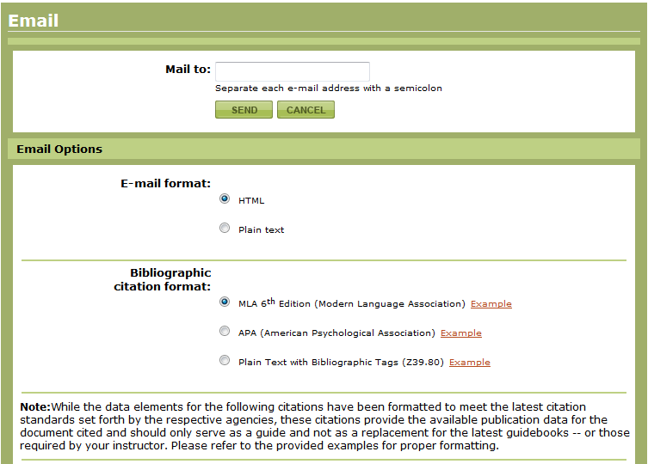
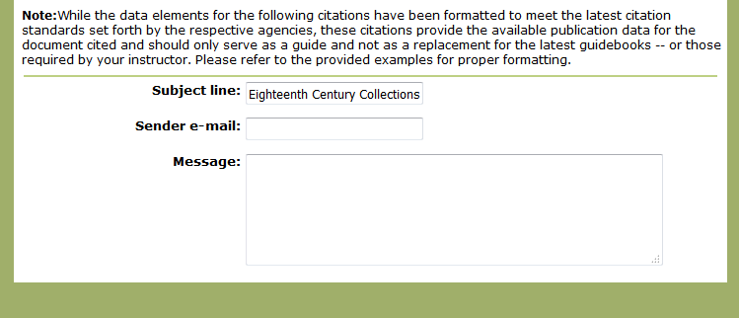
Navigation Tools-Email

Slide 15
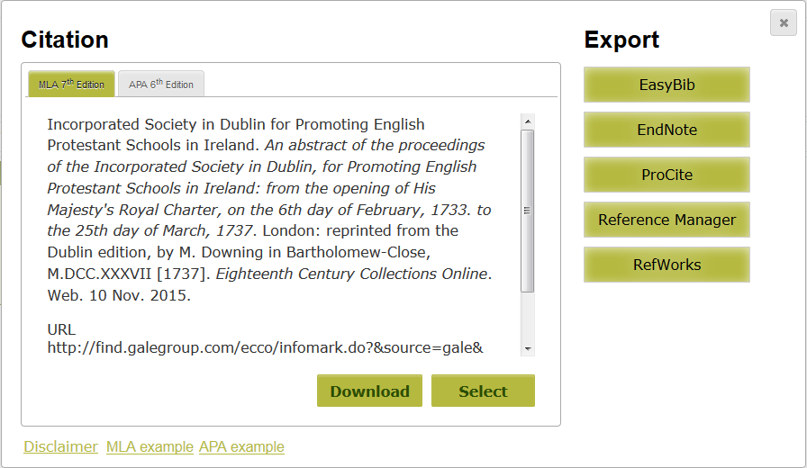
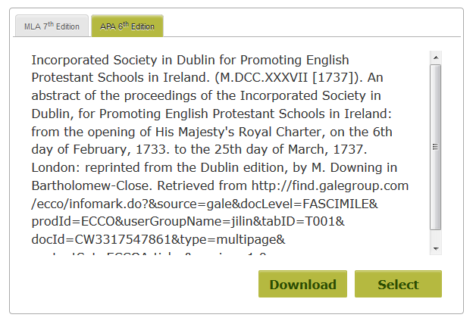
Navigation Tools-Citation Tools

Slide 16
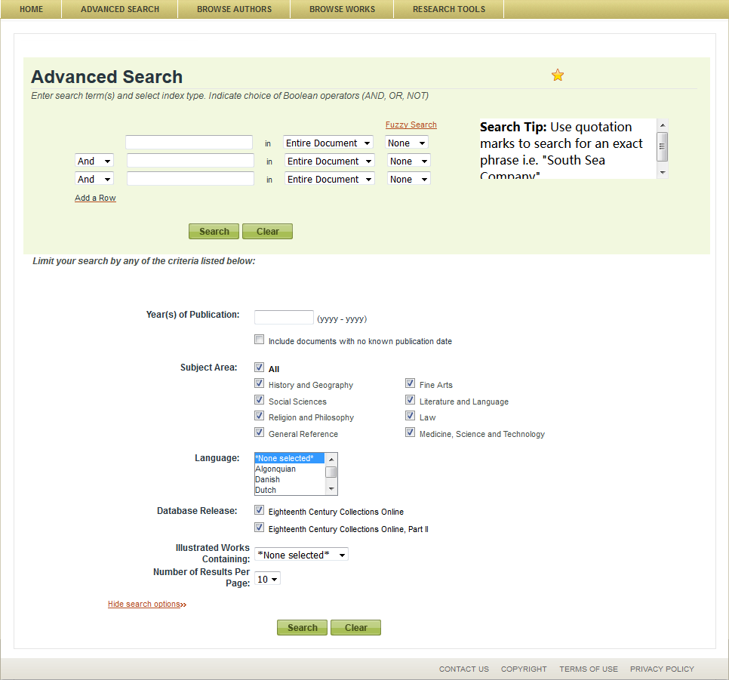
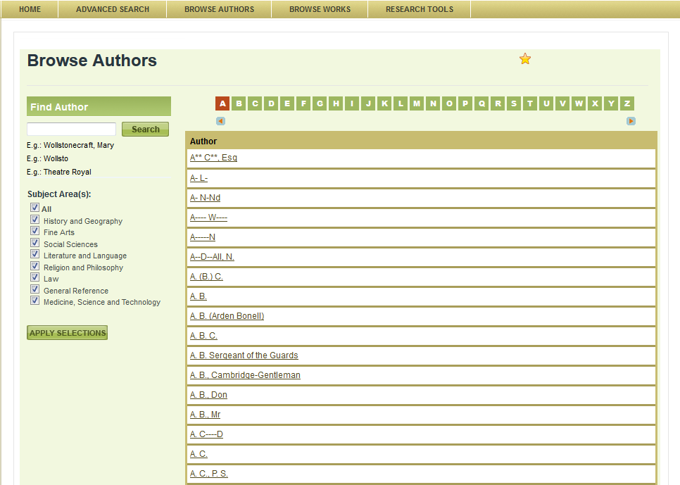
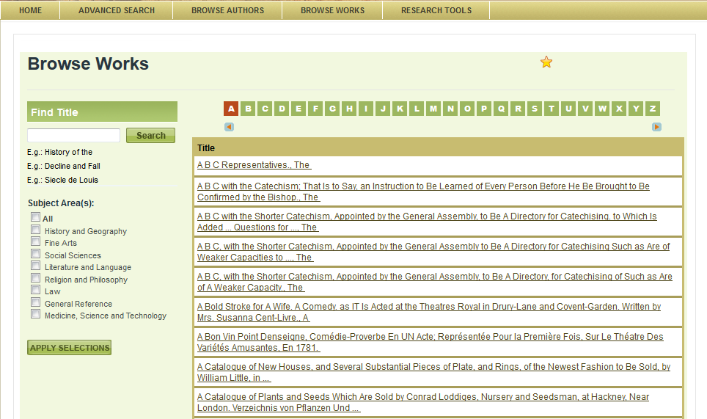

Slide 17
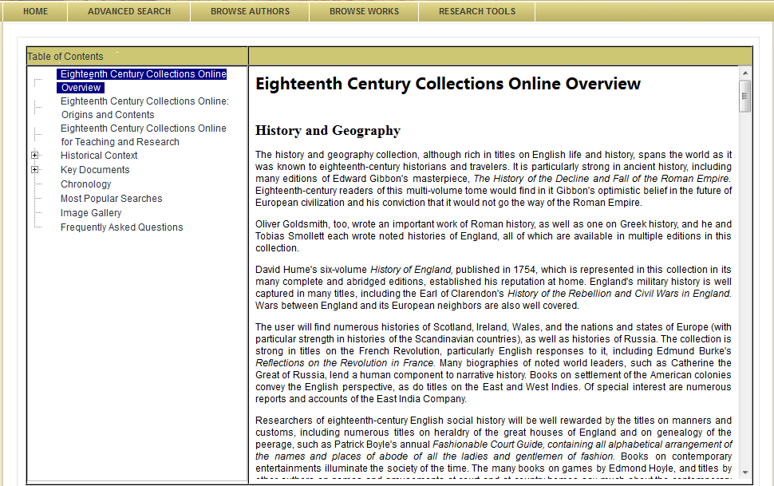
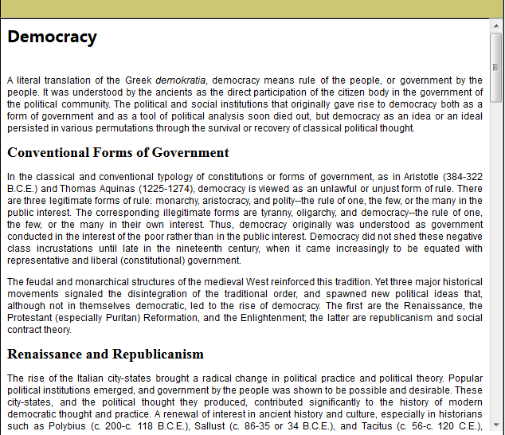
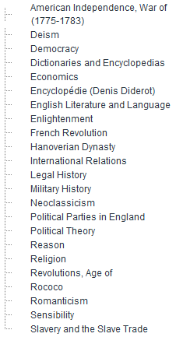

Slide 18
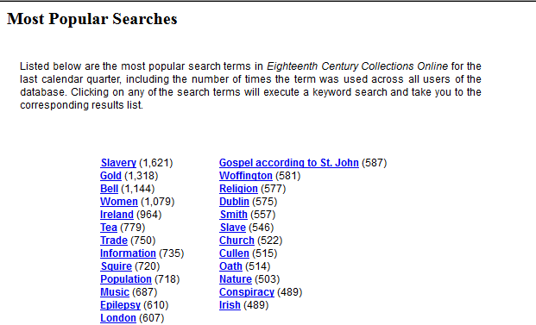

Slide 19
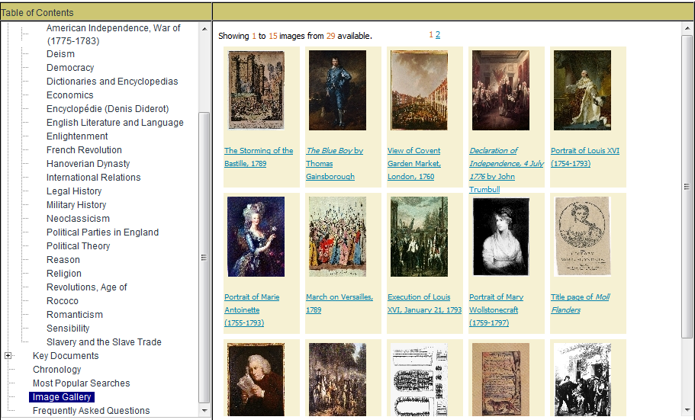

Slide 21
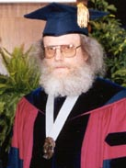
“Genuinely revolutionary”
“
A university that does not have ECCO is not a serious player in eighteenth-century British and American studies—in literature or in anything else. Any institution giving graduate degrees in eighteenth-century subjects reduces itself to below minor-league status if it does not provide ECCO to its students—and is putting its publishing faculty at a crippling disadvantage.
”
Rob Hume
Professor of English Literature
The Pennsylvania State University
Link to the full document: http://access.gale.com/nerl/documents/ECCO%20Whitepaper.pdf

Slide 22
“Democratized study”
“
… even the most Luddite of academics cannot deny that the immense benefits of this technology vastly outweigh those moments of nostalgia for a simpler age, especially when we remember that it was only a privileged few who then had either the resources or the leisure to spend years and travel long distances to pursue substantive research projects. Sources like ECCO have, quite simply, democratized the study of pre-modern print.
”
Andrea McKenzie
Professor, Department of History
University of Victoria

Slide 23
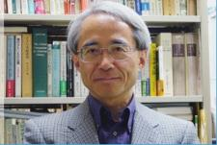
“A cultural landslide”
“
… For example, a researcher who has studied Milton for decades and a researcher who hasn't can now both talk knowingly about Milton. That may dishearten authorities, but for the progress of academic research I think it's maybe better that way. ... Perhaps, fifty years from now, the printed books of today may only retain their value as art objects. I think it's truly revolutionary. It may even be called a cultural landslide.
”
Kazuhiko Kondo
Professor, Graduate School of Humanities & Sociology
University of Tokyo

Slide 24
Thank you!

