Slide 1
Primal Picture
Ovid
李宁
培训经理
3D交互式立体解剖学数据库
吉林大学
2014年11月

Slide 2
Primal Pictures
创立于1991年，历经20多年的研究发展而成
透过核磁共振影像收录活体与大体资料达6500张以上
三维重现原始架构，不同于平面图画呈现方式，各部位采用阶层次架构方式呈现
超过10万种人体结构资料
通过动画真实再现肌肉功能、生 物力学、外科手术步骤和生理过 程等
其卓越的创新荣膺各类权威奖项

Slide 3
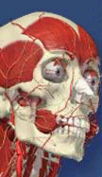
Primal Pictures
应用于临床应用、研究及教学的互动式
3D 动画人体解剖模型
无论临床应用、康复治疗、教学或科研，均可以无缝式进入三维动画，查看精确的解剖功能、生物力学、运动以及治疗和手术程序。

Slide 4
Primar Picture能提供什么
提供完整的全身解剖学模组以及9个区域解剖模组
提供临床医疗适用之模组功能
提供具有完整架构的文字说明
由解剖学专家学者撰写
具临床实证基础
提供相关结构的磁共振图像
提供相关病理投影片
提供人体实际运作或治疗之影片
提供测验题库

Slide 5
推荐使用IE，Google Chrome，火狐浏览器

Slide 6
登录方式
http://202.198.28.191/floatinganatomy

Slide 7
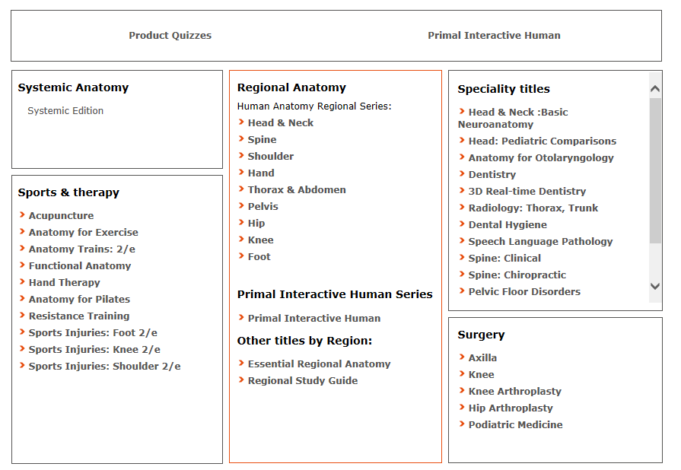
Primal Pictures Homepage （本地版）
特殊专题
系统解剖
局部解剖
手术
三维实时人体
运动创伤与治疗
Notes:
Say: from here we can access all the modules. Primal Pictures or Anatomy TV is a 3 dimensional anatomy tool. It comes to us from information gathered during the “visible human project” conducted by the National Library of Medicine and from further research done at University College London.
Primal Pictures consists of several modules (like chapters in a book). Some are overviews of the topic – Regional study guide, Anatomy Trains, Systemic edition and Test Bank. Some deal with regional anatomy (parts of the healthy human body) and some are specialist modules dealing with injury and treatment or dealing with specialist topics such as acupuncture, surgery, chiropractics etc.

Slide 8
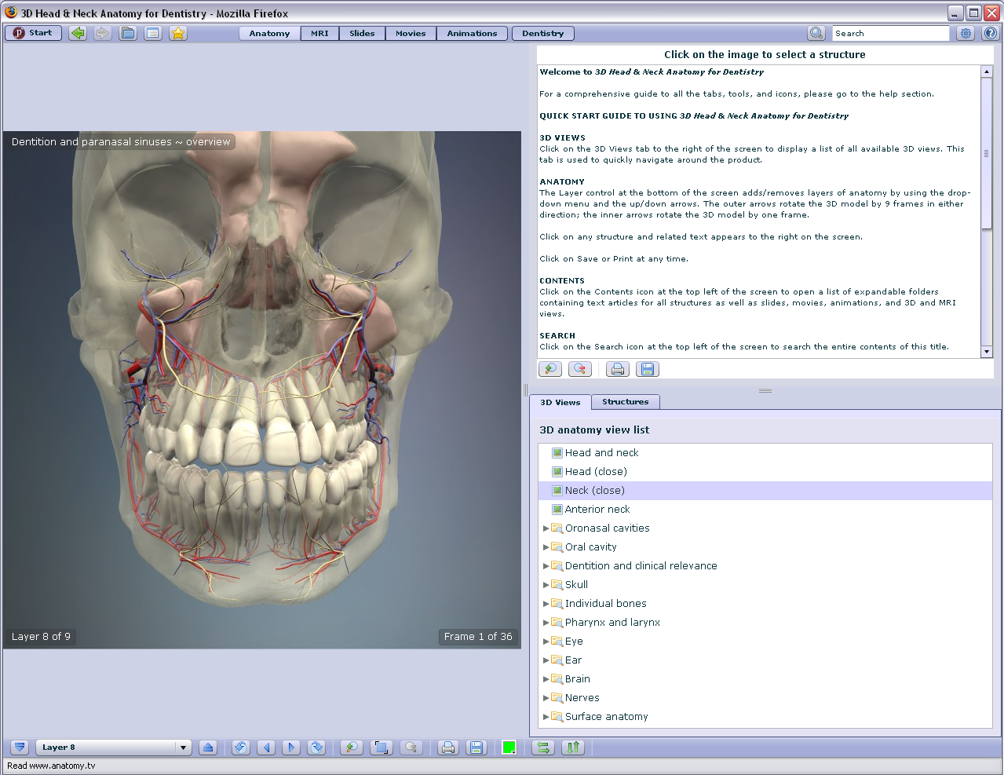
主页
Contents/Search, Index, bookmarks
内容检索，索引，书签
Contents Navigation
内容导航
Descriptive Text and Links
描述文字及链接
View and Structure Browsing
不同部位浏览
Layers/Slices, Rotation and Zoom
层面转换，旋转及放大
Notes:
Say:

Slide 9
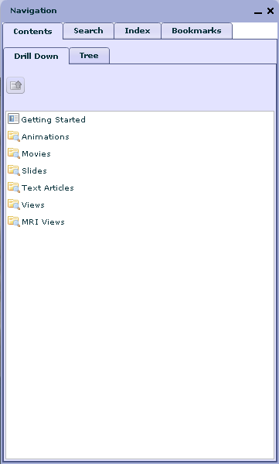
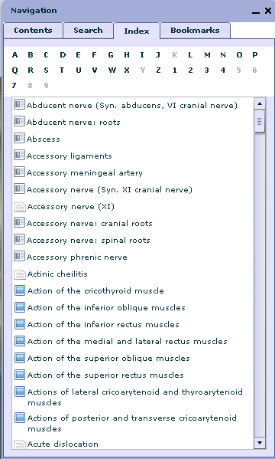
Contents/Search, Index, Bookmarks -内容检索，索引，书签
Notes:
Say: these menus at the top of the page (Content/Search, Index and Bookmarks) on the left allow you to search and browse the subjects in the module. To their right are the views and choices that we are exploring later. This is the most detailed access point. Within this list you are choosing from all the components in this module.

Slide 10
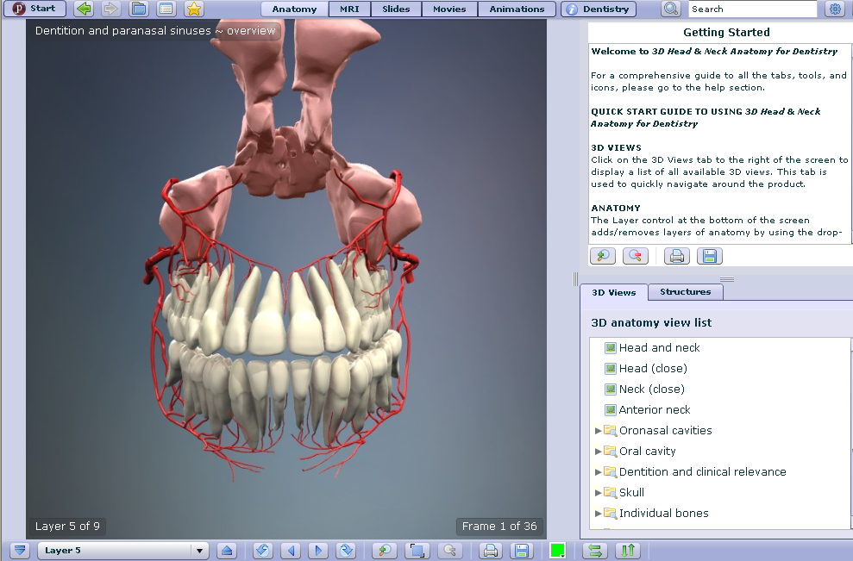
Layers, Rotation, Zoom and Output - 层面，旋转，放大，输出
Notes:
Say: the menus at the bottom allows you to rotate, add or remove layers (in anatomy) and zoom. Or on the left to view a specific structure or read and link to further information. Print or Save options are attached to the text and graphic displays and saving options to the movies.

Slide 11
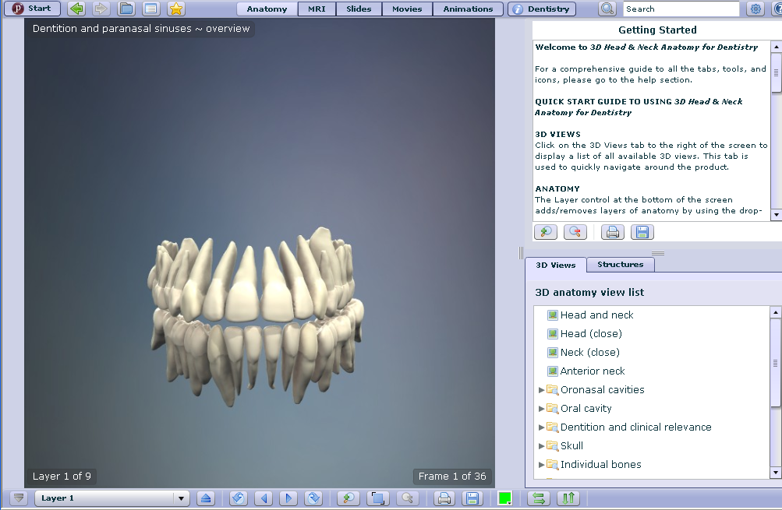
Layers, Rotation, Zoom and Output - 层面，旋转，放大，输出
Notes:
Say: the menus at the bottom allows you to rotate, add or remove layers (in anatomy) and zoom. Or on the left to view a specific structure or read and link to further information. Print or Save options are attached to the text and graphic displays and saving options to the movies.

Slide 12
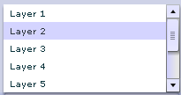
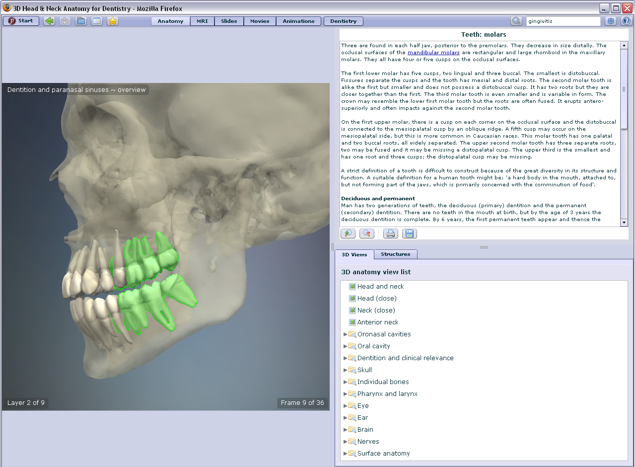
Layers, Rotation, Zoom and Output - 层面，旋转，放大，输出
Notes:
Say: the menus at the bottom allows you to rotate, add or remove layers (in anatomy) and zoom. Or on the left to view a specific structure or read and link to further information. Print or Save options are attached to the text and graphic displays and saving options to the movies.

Slide 13
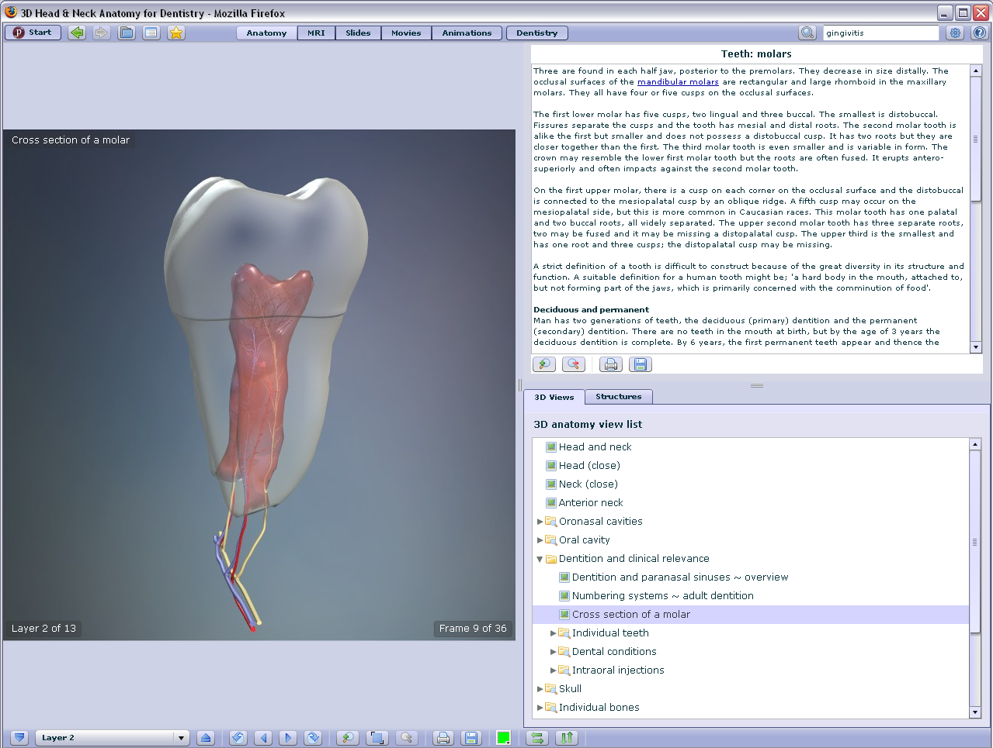
Cross Section of a Molar- 浏览找到臼齿的横剖图
Notes:
Say: I have chosen to open a 3d view folder on the right – Dentition and Clinical Relevance（齿列和临床相关性）, Cross section of a molar臼齿的横截面. Here is an example of a specific structure, note the text on the top right which may contain links to further text, movies, animations etc. 右侧包含一些链接、动画和视频 If I clicked the Structures link, I would see a list of structures in the view, the nerves for example. Note we are looking at Layer 2.

Slide 14
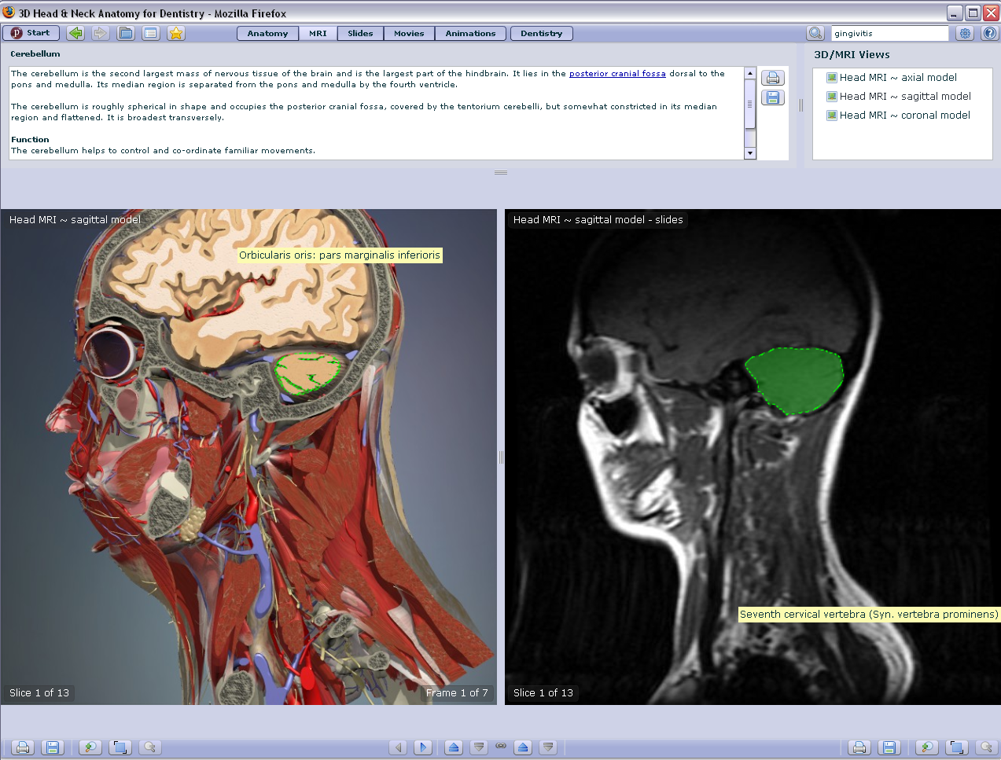
MRI-核磁共振成像
Notes:
Say: here is the MRI核磁共振成像 view (second button, top right) showing where these models came from – x-rays, CT scans MRIs etc were used to create these computer models. The MRI view shows the structure as slices rather than layers. This most clearly shows the relationship of the tissues. Choosing a structure in either view highlights on both. Choosing from the list of models (top right), changes the view from sagittal矢状 to coronal冠状 or axial轴向.

Slide 15
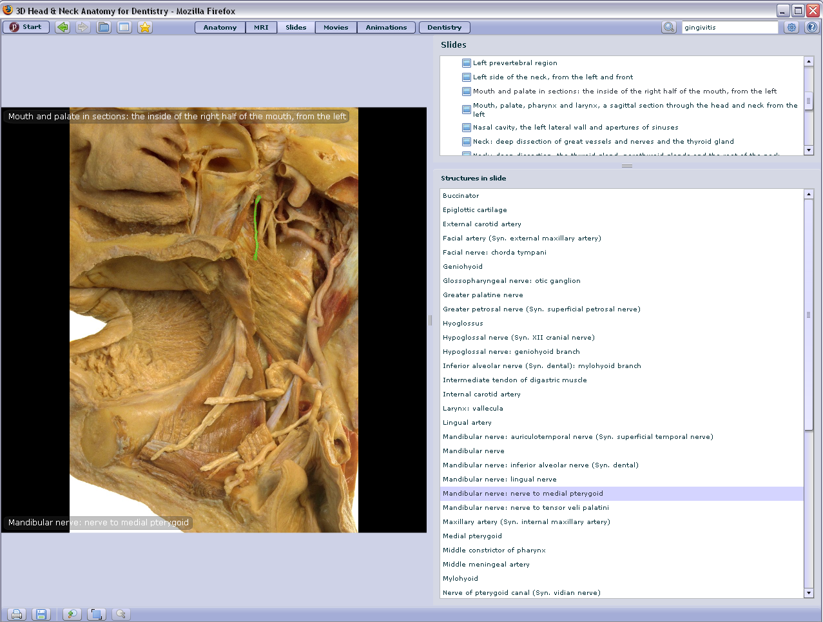
Slides-幻灯片
Notes:
Say: Slides (third button, top right) can be pictures of preserved slides or from life, with highlighted structures. Note I have selected mandibular nerve 下颌神经and see it highlighted on the left (in green).

Slide 16
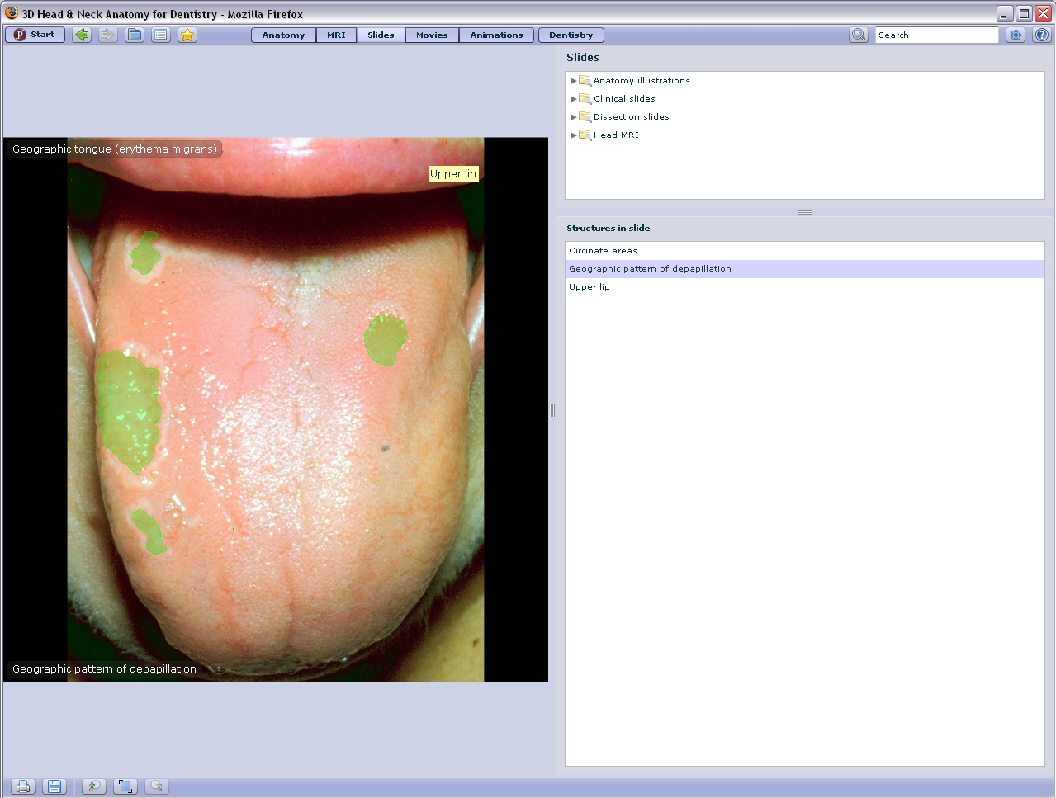
Slides-幻灯片示例
Notes:
Say: this is a different type of slide. A photograph showing the papilla乳突状突起 on the tongue in this example (note green highlighting, this is the selected structure).

Slide 17
Movies-影视
Notes:
Say: there are also Movies (fourth button, top right), where movement is an important part of understanding – how a muscle moves a joint (the jaw) for example.

Slide 18
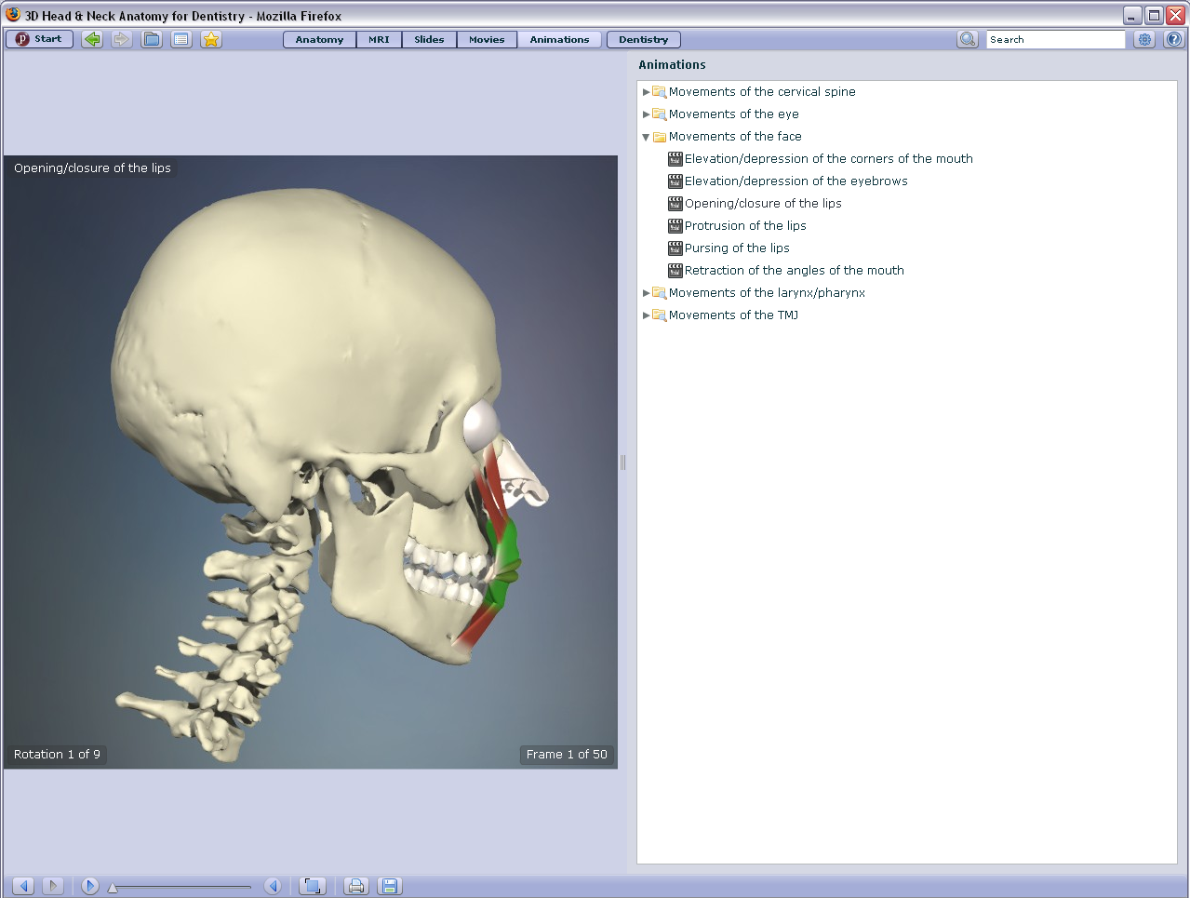
Animations-动画
Notes:
Say: And animations which may also be used for this purpose – seeing how a muscle moves a joint, in this case the jaw.

Slide 19
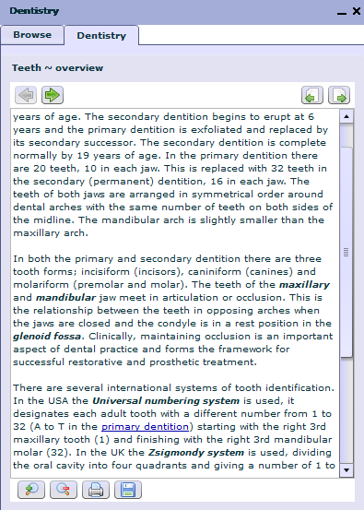
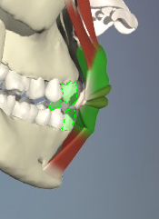
Dentistry
Notes:
Say: the dentistry text is browsable text, richly endowed with links which take us out into the text, views, movies etc.

Slide 20
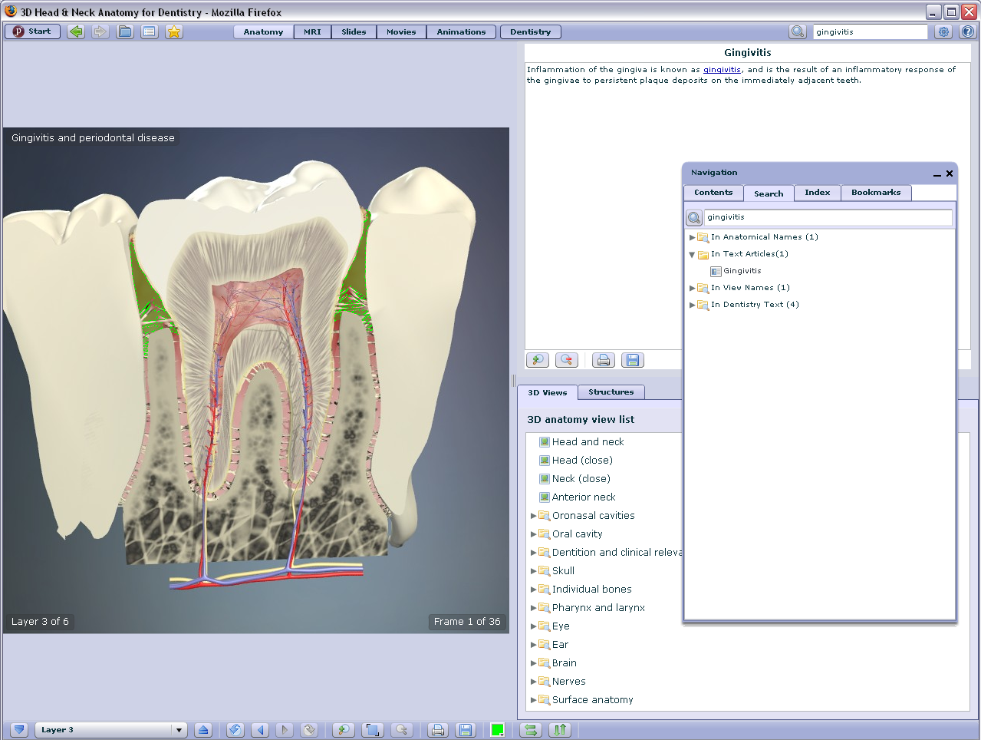
Searching example “Gingivitis”牙龈炎
Notes:
Say: here is a searching example showing how the text, view and label all come together. The Dentistry section offers browsable text which I can navigate then follow links into the views, models illustrations animations etc.
In being able to navigate and explore these views in great detail from many different points of view the student can become familiar with the structures in the head and neck, even without access to cadavers.
Example Search gingivitis in Content Search and follow link to “In Text Articles” , choose a different layer and rotate to show the 3d access.
Example 2 Choose 3d views, dentition, cross section of a molar. Then choose structures, mandibular nerve to highlight that structure (in the illustration).

Slide 21
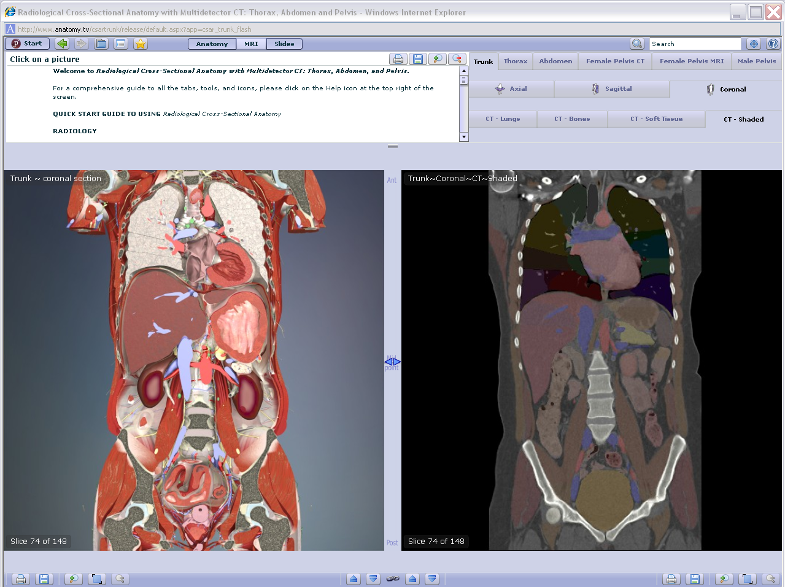
Primal Pictures Modules – 模块
Specialty Titles: Radiology
Notes:
Say: This is a specialty radiology module.

Slide 22
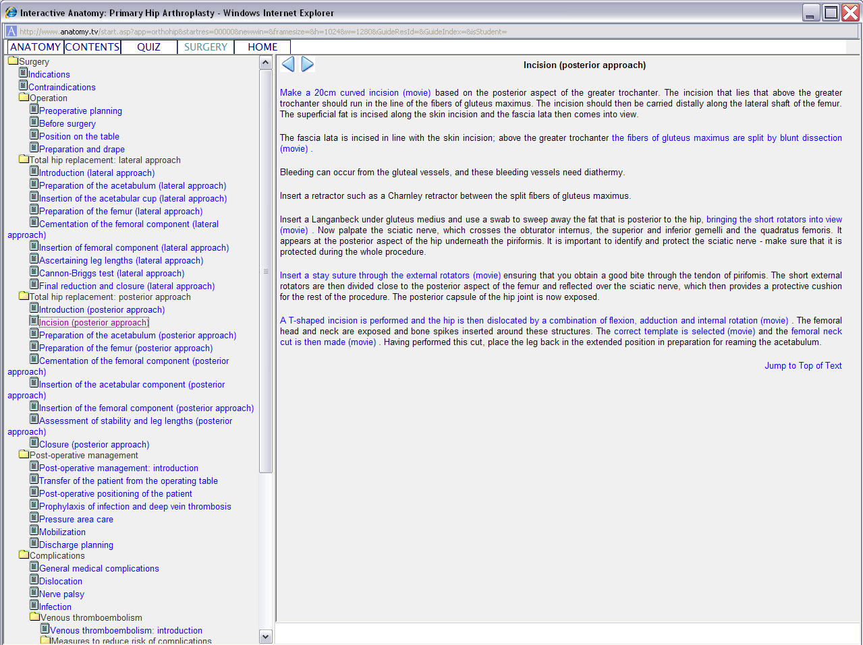
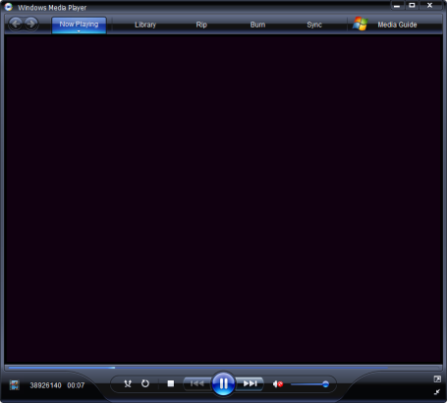
Primal Pictures Modules – 模块
Surgery Titles: Hip Arthroplasty
全髋关节置换术
Notes:
Say: This is a surgery module about the hip (good for movies).

Slide 23
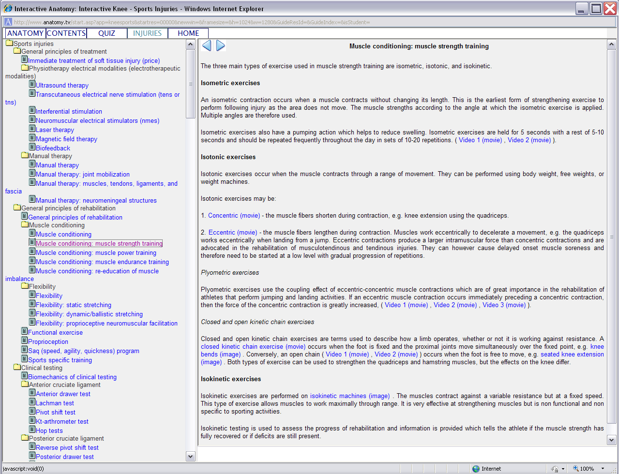
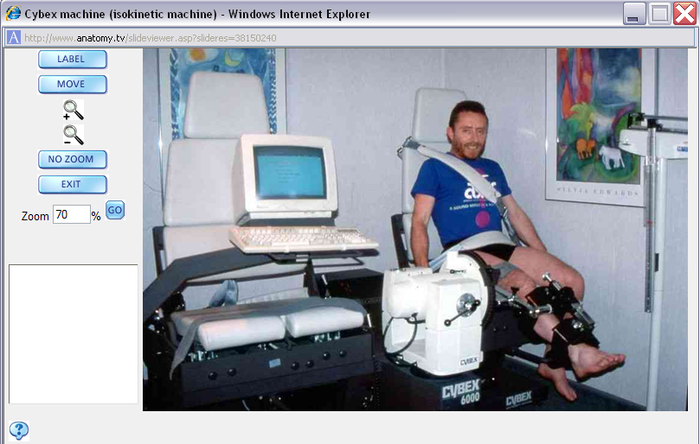
Primal Pictures Modules – 模块
Sports Injuries Titles: Knee Injuries
Notes:
Say: This is a sports injuries module about the knee.

Slide 24
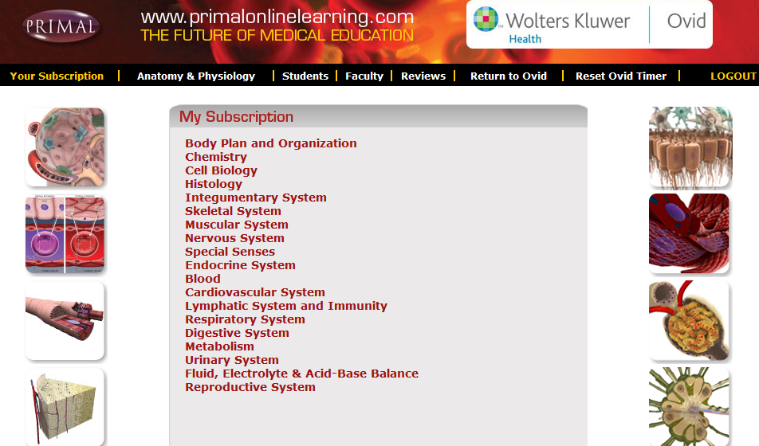
Primal Pictures module — Anatomy & Physiology
系统解剖与生理学部分，分为19个模块，全面讲解系统解剖与生理学。
Notes:
解剖和病理学

Slide 25
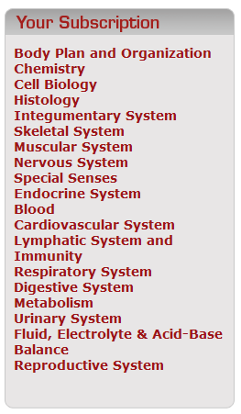
APO – Module Organization 模块组成
Basic introductory topics, nomenclature and pronunciation, cellular structure, tissue organization and biochemistry
Systemic anatomy modules - listed system by system but including specific organs, tissues and examples
Notes:
术语、发音细胞结构、组织结构和生化过程

Slide 26
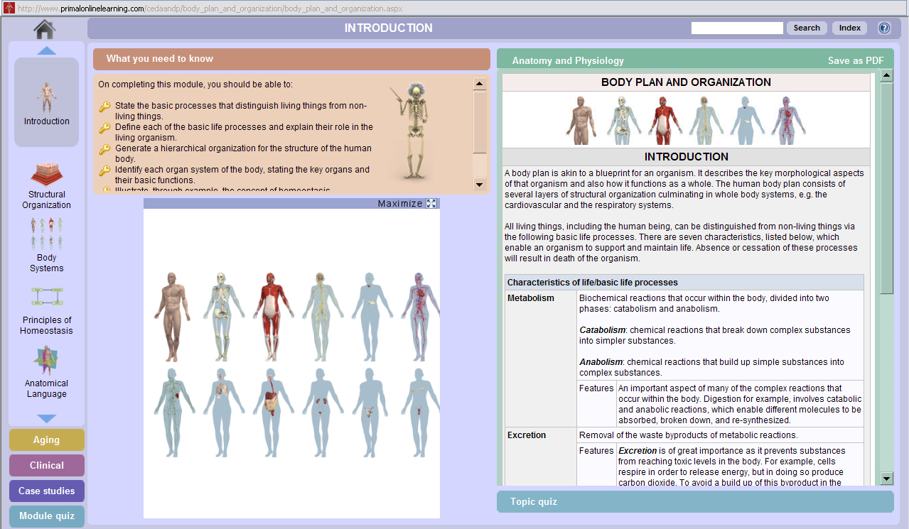
APO – Your Subscription Menu Access to Modules

Slide 27
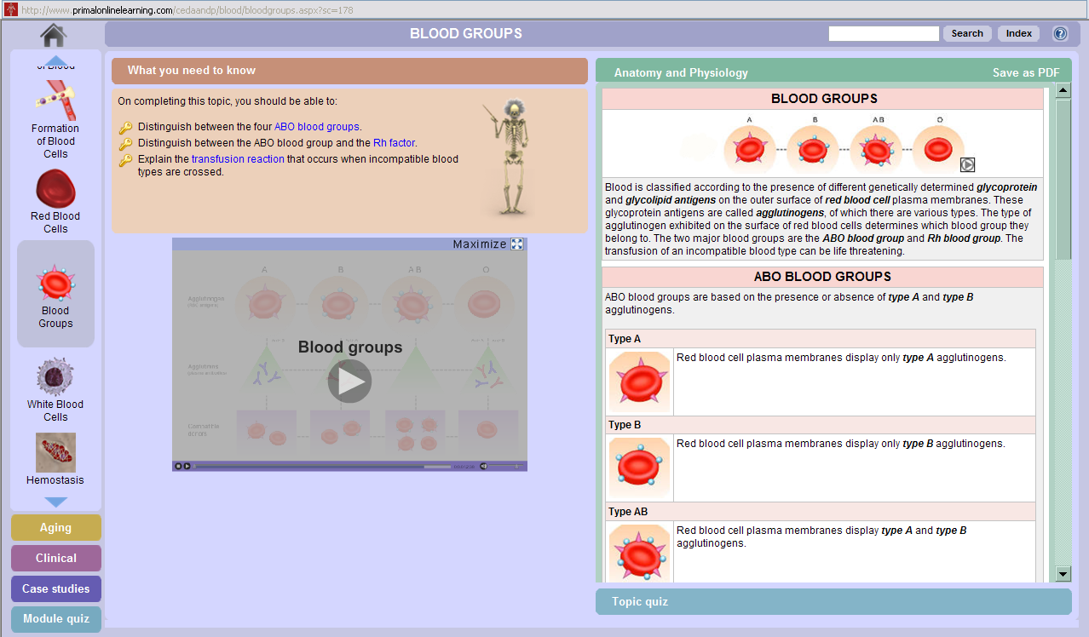
APO – Module View
Section Navigation

Slide 28
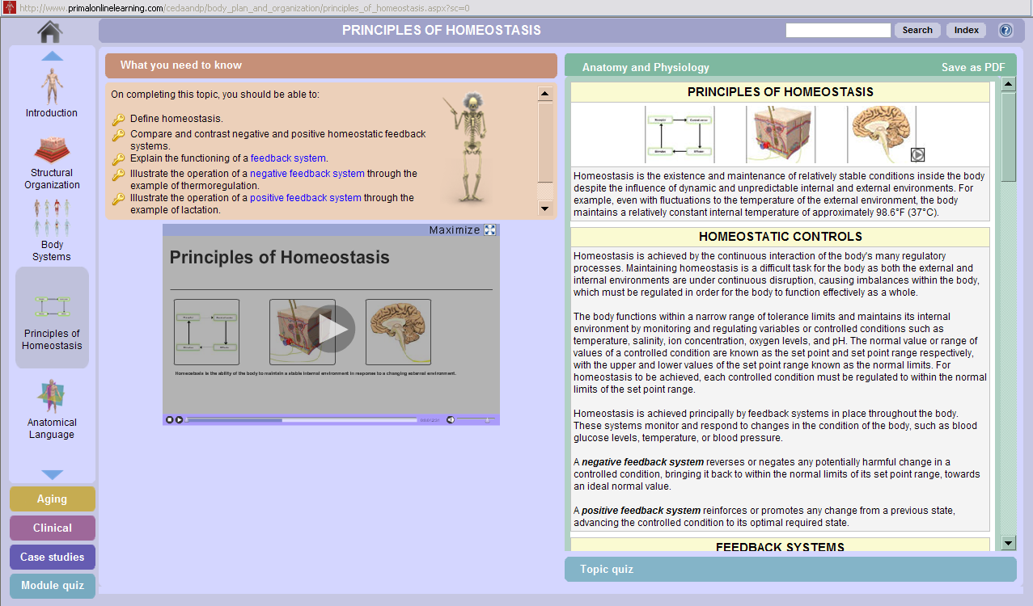
APO – Navigation and Content
Guide and Section Navigation
Movie
Content Tabs

Slide 29
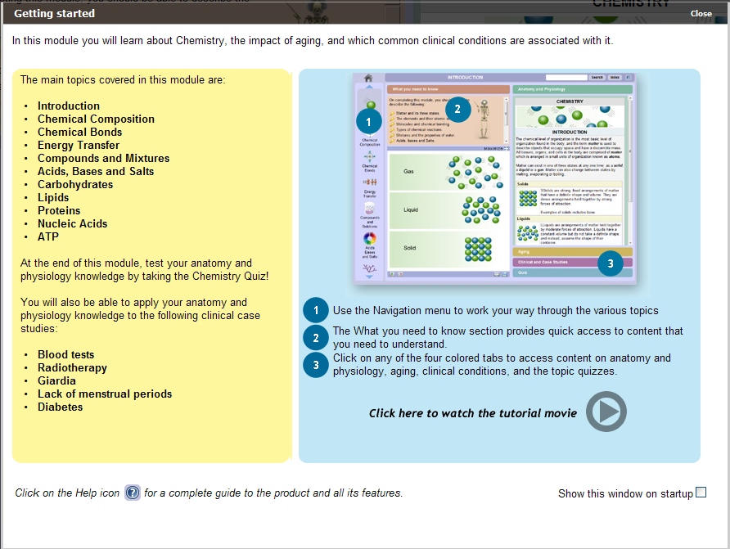
APO – Basic Information Chemistry Module Guide

Slide 30
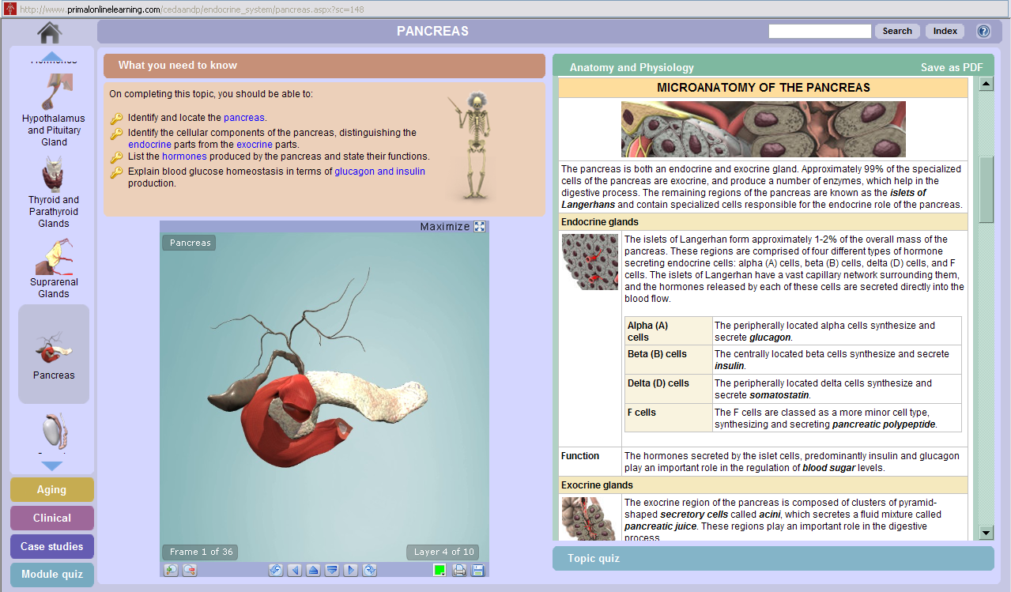
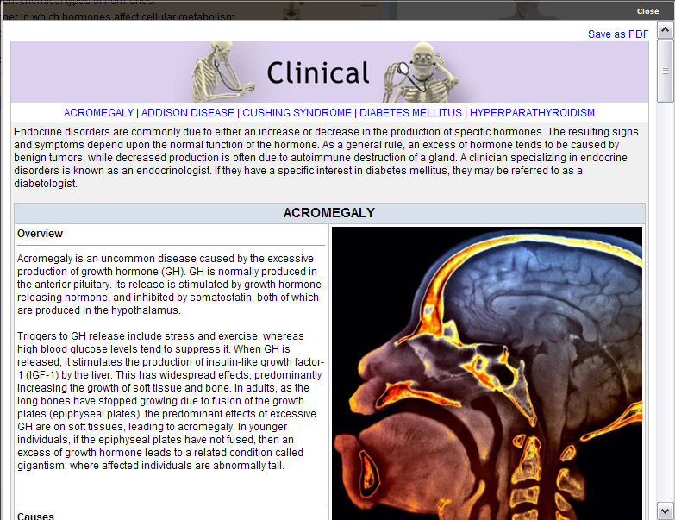
APO – Endocrine System
Anatomy – with layers and rotation

Slide 31
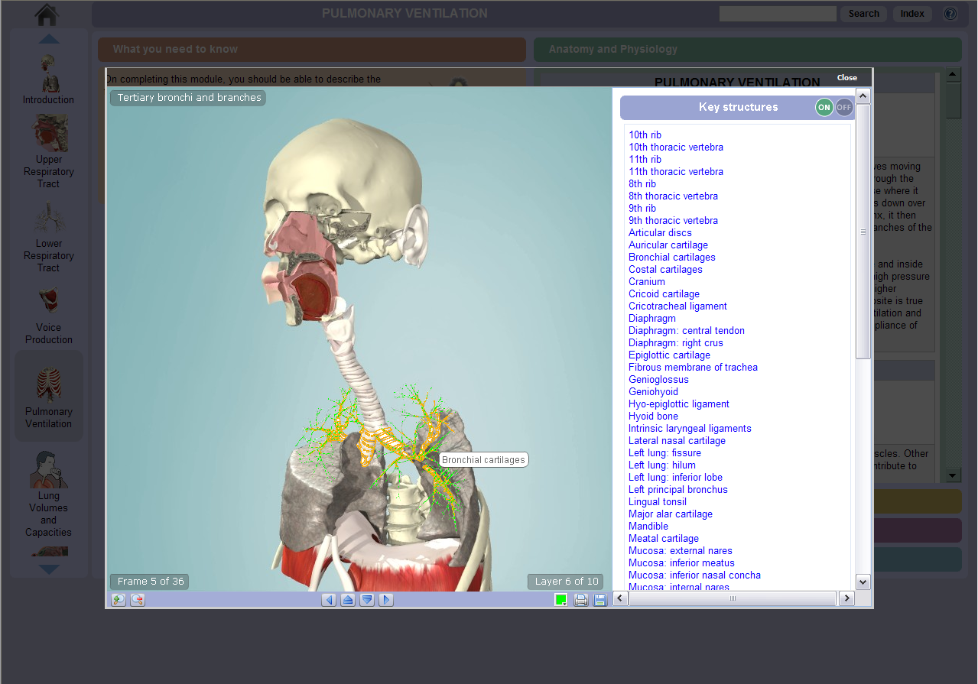
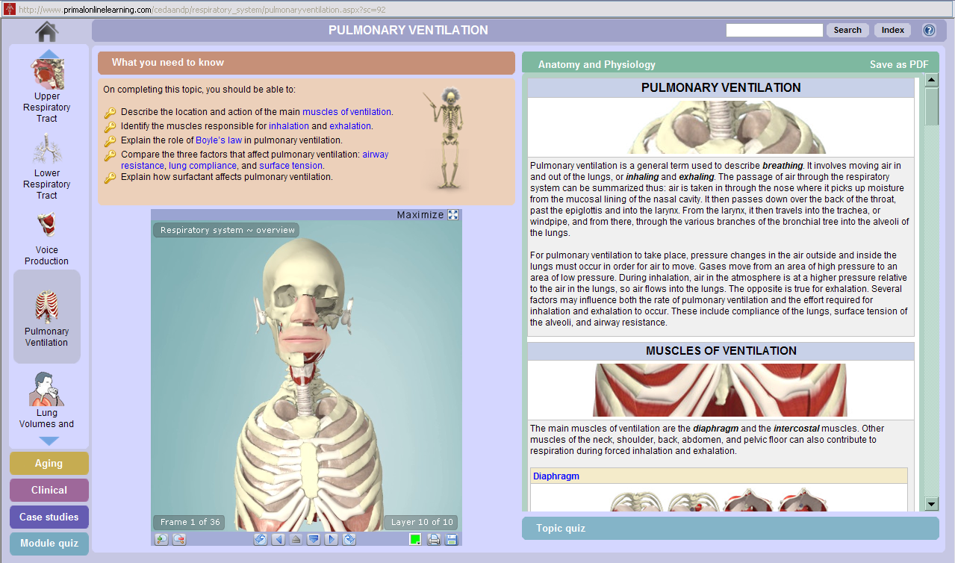
APO – Pulmonary Ventilation（肺通气）- maximized model
Anatomy Maximized – with layers, rotation and structures

Slide 32
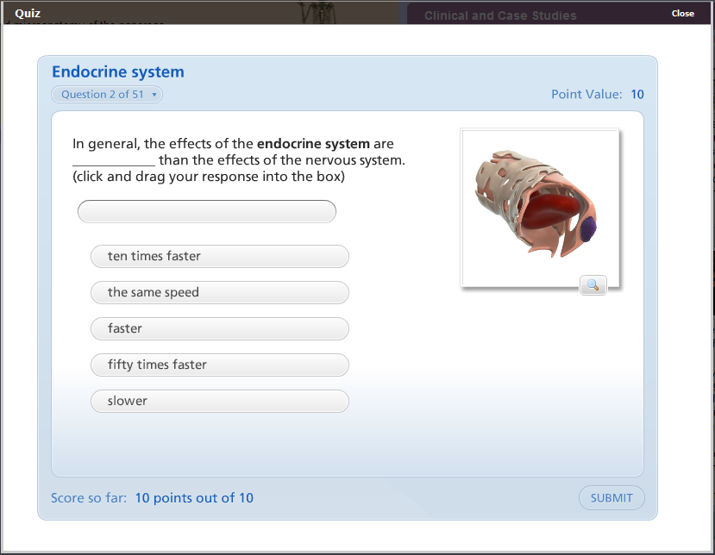
APO – Quiz

Slide 33
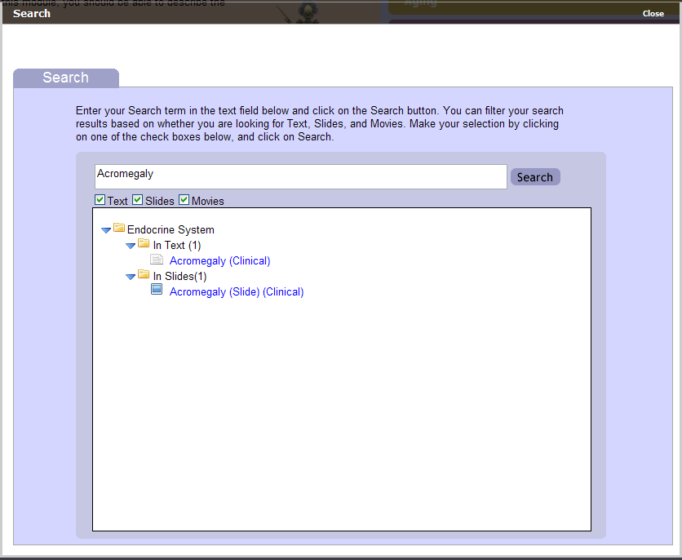
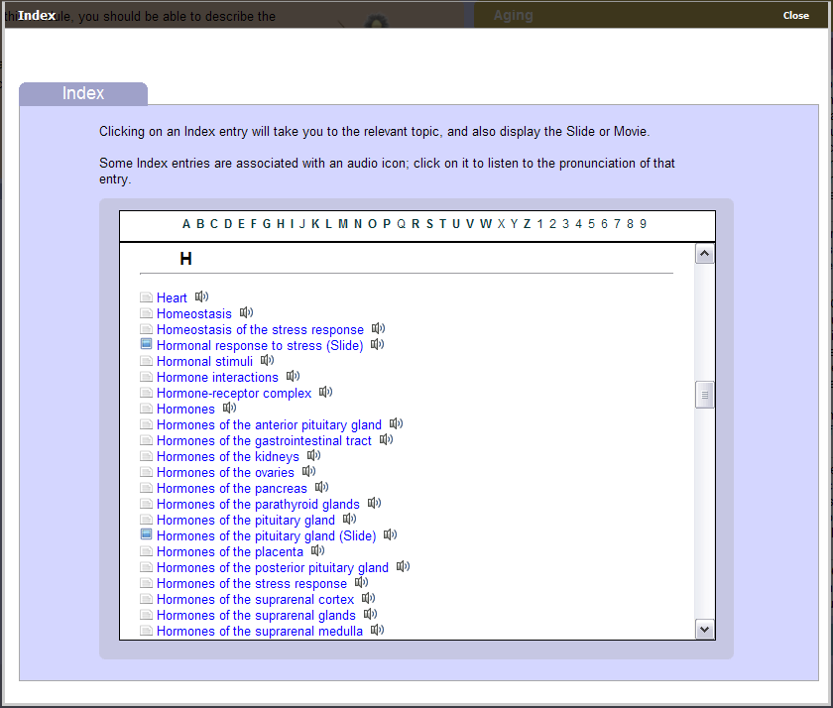
APO – Searching and Browsing

Slide 34
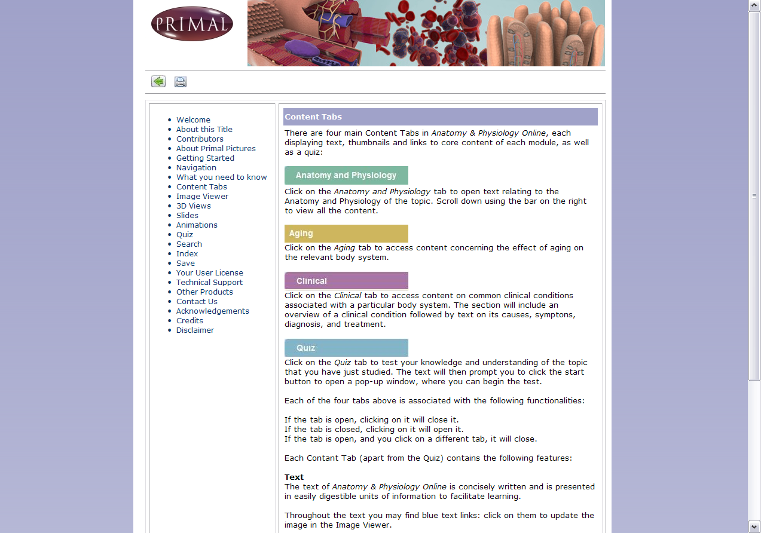
APO – Help
Notes:
The help

Slide 35
点击“Log Off”退出数据库

Slide 36
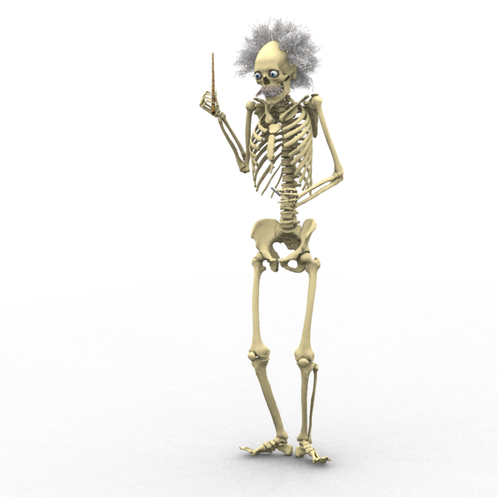
大家还有什么问题？ 谢谢！
李宁
Ovid培训经理
Ning.li@wolterskluwer.com
support@ovid.com

